Slide 1
Pathways in Crisis Services Project
Center for the Application of Substance Abuse Technologies (CASAT)
CAS 355: Individual and Group Addiction Treatment
Notes:
Pathways to Crisis Services (PICS) Curriculum Infusion Packages (CIPs) are a product for educators and trainers developed by the Center for the Application of Substance Abuse Technologies (CASAT). The main developers of crisis services materials are April Lang-Barroga, LMFT, LCADC, NCC and Bianca D. McCall, LMFT. Additional guidance and editing support were provided by, Terra Hamblin, MA, NCC, BC-TMH and Sophia Graham, BS.
This product was developed to help community college/university faculty, as well as clinical supervisors and recovery support staff have access to brief, science-based content to provide materials that can be easily infused into existing substance use disorder and related courses (e.g., social work, nursing, criminal justice, foundation of addiction courses, ethics, counseling courses, etc.). Individuals can select the specific content to infuse into existing curricula/materials depending on the specific needs of their learners. Each slide in the slide decks contains notes to provide guidance on the topics along with references and handouts where appropriate. If you require further information, please do not hesitate to contact the CASATs PICS Project Staff located at CASAT (775-784-6265).
You are free to use these slides and pictures, but please give credit to PICS when using them by referencing the PICS Program at the beginning of your presentation.
Funding for this product/publication was made possible in whole or in part by the Nevada Division of Public and Behavioral Health Bureau of Behavioral Health, Prevention, and Wellness (DHHS). The views expressed in these materials do not necessarily reflect the official policies or views of DHHS or the State of Nevada nor does mention of trade names, commercial practices, or organizations imply endorsement by the U.S. Government or the State.
Additional resources are available to enhance and support the information provided in this brief presentation.
Date last updated: January 2023

Slide 2
Curriculum Infusion Introduction
Notes:
This slide deck was developed for the University of Nevada, Reno’s CAS 355 Individual and Group Addiction Treatment 3 credit undergraduate course. This course provides an overview of basic skills counseling skills. The primary theoretical model presented is Motivational Interviewing, though other theories are also addressed. A primary goal of the course is to learn skills effective for relationship development, problem identification, and counselor issues that might impede effective helping. The course content requires practice and the application of theoretical material. This course is an intensive learning experience that provides numerous opportunities for students to identify, "experience," and practice the basic individual and group counseling skills. Teaching methods include role-play activities, individual counseling interactions, and an ongoing group experience with other students.
This slide deck can easily be infused into similar academic addiction treatment courses in full or in part to supplement current addiction treatment, recovery, and prevention curriculum.
SOURCES:
Center for the Application of Substance Abuse Technologies (CASAT) Academics: https://casat.org/academic/
UNR Course Descriptions: https://catalog.unr.edu/content.php?catoid=45&catoid=45&navoid=47663&filter%5Bitem_type%5D=3&filter%5Bonly_active%5D=1&filter%5B3%5D=1&filter%5Bcpage%5D=9

Slide 3



Topics
Crisis Response System
Suicide Prevention
Trauma
Cultural Considerations
Compassion Fatigue
Notes:
Read slide to review topics that will be covered.
Image Credit:
Emergency Image Credit: Picpedia
Man with Head in Hands Image Credit: PxHere
Woman Image Credit: Wikimedia Commons

Slide 4
Disclaimer
This presentation may include readings, media, and discussion around topics such as suicide, trauma, and crisis intervention and may be difficult.
Please listen to yourself… and reach out if you are having difficulty with these topics.
Notes:
Read Disclaimer: This presentation may include readings, media, and discussion around topics such as suicide, trauma, and crisis intervention and may be difficult.
In addition, it is recommended and encourage for you to care for your safety and well-being. If this topic and conversation elevates you, please reach out to someone and seek help immediately.

Slide 5

Notes:
SUBJECT MATTER: CRISIS RESPONSE SYSTEM
Transition slide: Inform students we will be covering Crisis Response System information. This will include an overview of material from your previous CAS minor courses.
Image: Picpedia

Slide 6
Psychological First-Aid (PFA) for Resilience
8 Core Actions
Contact and Engagement
Safety and Comfort
Stabilization
Information Gathering
Practical Assistance
Connection with Social Supports
Information on Coping
Linkage with Collaborative Services
Notes:
SUBJECT MATTER: CRISIS RESPONSE SYSTEM
READ:
In CAS 254 you reviewed the National Guidelines for Behavioral Health Crisis Services and the Crisis Services in Alignment image. Remember that in a given crisis system 80% of mental health crisis can be resolved by phone!! CAS 255 you reviewed the Crisis Response Systems in Nevada that include: call centers (crisis support services), 24/7 mobile crisis (mobile crisis response team (youth and families) and mobile outreach safety teams (attached to local law enforcement), crisis stabilization programs (2 in Las Vegas, 1 in Reno), and the essential principles and practices (trauma-informed care, suicide safer care, peer to peer support). You also reviewed Nevada’s Crisis Continuum and the problems we have seen with crisis response systems across the nation. In CAS 354 you reviewed the 6 Phases of Disaster Response and Grief Cycles.
In relation to this course we are going to discuss The eight PFA Core Actions which include:
Contact and Engagement: To respond to contacts initiated by survivors, or to initiate contacts in a non-intrusive, compassionate, and helpful manner.
Safety and Comfort: To enhance immediate and ongoing safety, and provide physical and emotional comfort.
Stabilization (if needed): To calm and orient emotionally overwhelmed or disoriented survivors.
Information Gathering on Current Needs and Concerns: To identify immediate needs and concerns, gather additional information, and tailor Psychological First Aid interventions.
Practical Assistance: To offer practical help to survivors in addressing immediate needs and concerns.
Connection with Social Supports: To help establish brief or ongoing contacts with primary support persons and other sources of support, including family members, friends, and community helping resources.
Information on Coping: To provide information about stress reactions and coping to reduce distress and promote adaptive functioning.
Linkage with Collaborative Services: To link survivors with available services needed at the time or in the future.
Discussion: How might you ensure you implement all 8 when working with someone?

Slide 7
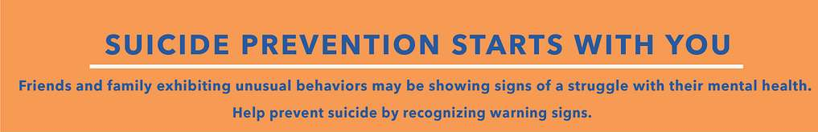
Notes:
SUBJECT MATTER: SUICIDE PREVENTION
READ: Inform students we will be reviewing suicide prevention risk and protective factors, suicide risk assessments, and how to work with someone who is suicidal. Please be aware of how you are responding to the material and how you might have discussions of suicide with your clientele. Suicide is a difficult topic to learn about and experience. Please be considerate of your students when they are sharing.
Image Credit: Picryl

Slide 8
Survivors of Suicide Attempts Group (SOSA)
Values of the Support Group
      Inspire hope and help people find meaning and purpose in life
      Build community connectedness
      Engage and support family and friends
      Respect and support cultural, ethnic, and spiritual beliefs and traditions
      Provide timely access to care and support
      Preserve dignity and counter stigma, shame, and discrimination
      Promote choice and collaboration in care
      Connect persons to peer support
      Didi Hirsch Foundation, 2021
Notes:
SUBJECT MATTER: SUICIDE PREVENTION
READ slide to class.
Reference:
Hirsch, D. (2021, April 23). Best Practices Manuals & Toolkits - Didi Hirsch Mental Health Services. Didi Hirsch Mental Health Services -. https://didihirsch.org/download-best-practices-manuals-toolkits/
Manual_for_Support_Groups_for_Survivors_of_Suicide_Attempts.pdf

Slide 9
Goals for the Support Group
Short-term goals of the group include:
Maintaining participant safety and managing risk
Reducing internalized/perceived stigma
Increasing comfort with and ability to speak about the thoughts and feelings that led to their suicide attempt
Decreasing the likelihood of another attempt by learning how to recognize and cope with thoughts of suicide
Increasing coping skills as they relate to suicidal thoughts
Didi Hirsch Foundation, 2021
Notes:
SUBJECT MATTER: SUICIDE PREVENTION
READ slide (continued from previous slide)
Reference:
Hirsch, D. (2021, April 23). Best Practices Manuals & Toolkits - Didi Hirsch Mental Health Services. Didi Hirsch Mental Health Services -. https://didihirsch.org/download-best-practices-manuals-toolkits/

Slide 10
Goals for the Support Group
Short-term goals of the group (continued):
Increasing knowledge about, and the likelihood of using, safety planning tools and resources
Increasing connectedness, including access to peers who can support each other in times of crisis
Creating a “built-in” safety net where members are comfortable sharing thoughts/risk for suicide without fear of how others will react
Managing and reducing lethal means
Increasing hopefulness
Didi Hirsch Foundation,2021
Notes:
SUBJECT MATTER: SUICIDE PREVENTION
READ slide (continued from previous slide)
Reference:
Hirsch, D. (2021, April 23). Best Practices Manuals & Toolkits - Didi Hirsch Mental Health Services. Didi Hirsch Mental Health Services -. https://didihirsch.org/download-best-practices-manuals-toolkits/

Slide 11
Goals for the Support Group
Long-term goals include:
Reducing suicidal desire
Reducing suicidal intent
Increasing protective factors
Preventing future attempts
Creating a peer support network
Increasing in individual’s ability to plan for the future
Notes:
SUBJECT MATTER: SUICIDE PREVENTION
READ slide (continued from previous slide)
Reference:
Hirsch, D. (2021, April 23). Best Practices Manuals & Toolkits - Didi Hirsch Mental Health Services. Didi Hirsch Mental Health Services -. https://didihirsch.org/download-best-practices-manuals-toolkits/

Slide 12
Trauma
Notes:
SUBJECT MATTER: TRAUMA
Transition slide: The following section will be an overview of trauma and how it impacts a person.
Image Credit: Wikimedia Commons

Slide 13
Intergenerational Trauma
The more prepared we are for danger, the less our brain perceives important relational information such as what we need, value, and what we want to be able to engage in.
DISCUSSION:
What impact could intergenerational trauma have on your learning environment and experiences as a student?
Notes:
SUBJECT MATTER: TRAUMA
There is a lot of research on epigenetics and how generations of trauma are manifested in the behavioral health effects of special groups and populations.
The literature suggests Intergenerational trauma is the adaptive characteristics- us being prepared for dangers met in a previous generation, and they are now manifesting similar adaptations in the present day.
Examples of where you may expect to see intergenerational trauma are in communities of
Holocaust Survivors
Descendant generations from Slavery and those victimized by systemic racism
Indigenous Native American Culture
Chinese Culture
Mexican Culture- whose land was stolen and renamed America with cities like Las Vegas, San Diego, San Francisco
Let’s take a look at intergenerational trauma from a socio-cultural perspective- There is a specific set of 4 Core Values common to groups of people disproportionately experiencing mental health, substance use, and suicide crises:
Integrity before all else– Evidence of Intergenerational Trauma is when integrity is defined as having tolerance for pain and suffering.
Enduring pain to appear uninjured and suffering in silence.
Excellence in all things we do– Evidence of Intergenerational Trauma is when excellence is misconstrued as perfection.
Service/ Performance before self – Evidence of Intergenerational Trauma is when service and/or performance comes at the complete sacrifice of self.
These are examples of how intergenerational trauma impacts the person-
DISCUSSION:
Ask the question: what impact do you believe intergenerational trauma has on your learning environment and experiences as student?

Slide 14
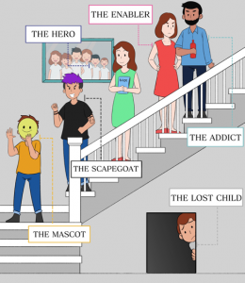
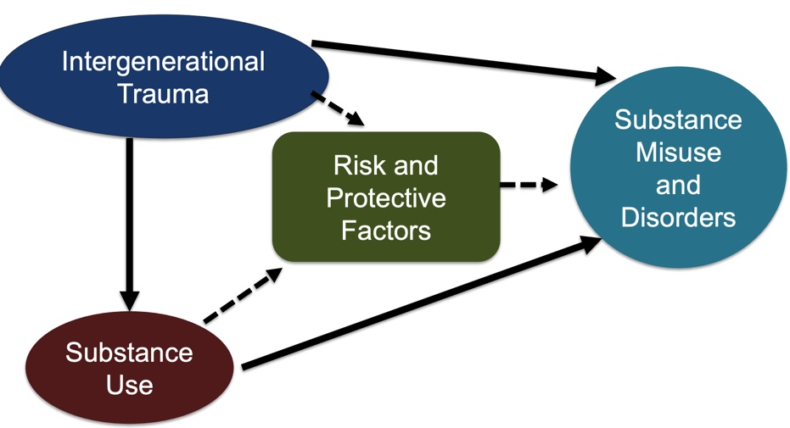
Intergenerational Trauma &
Substance Misuse and Disorders
Notes:
SUBJECT MATTER:TRAUMA
Most people assume addiction is a one-person problem, and that it’s the addict’s sole responsibility to get stop using their drug of choice and begin to get sober. While it’s true every person battling addiction or who is in recovery from a substance use disorder (SUD) has an individual journey, the roots of addiction rarely begin with the individual with the SUD.
Many people have experienced intergenerational trauma that heavily influences their substance abuse and recovery process. Many people seeking help don’t know their addiction or substance abuse is generational. Additionally, they may have blocked out traumatic events that contributed to their addiction. In such cases, treatment is often harder and return to use (relapse) is more likely.
Trauma of any kind forces us to do things we would never do under normal circumstances. We will use any remedy to cope with the pain, including drugs and alcohol, even if we aren’t sure exactly where the pain originates. Often, intergenerational trauma occurs because the survivors and immediate witnesses have not effectively processed their grief. If they are unable to do that, the second and third generations become trauma “carriers.” Often, one person is “chosen” to carry and deal with the trauma. If left to do this alone, that person can easily turn to addiction and substance abuse.
The picture of the family on the slide shows you the Dysfunctional Family Roles in Addiction (The Dysfunctional Family Roles in Addiction is an evidence-based teaching model and the role of "The Addict" is only interchangeable with "The Abuser“)
THE ADDICT OR ABUSER, --battling their addiction
THE ENABLER OR CODEPENDENT, --cleaner/fixer upper, enables the addicts behaviors
THE SCAPEGOAT OPPOSITE THE HERO, --receives neg attention in the family, identified as the “Problem”
THE MASCOT --class clown, uses humor to bring light to family issues
THE LOST CHILD—pulls away from the fx, attaches to another person(s) outside the fx (and if/when this person(s) disappears or ends, this person will look for someone to replace them and loses all sense of self)
All of these roles are in place to maintain the dysfunction and the addiction. Brings a balance of function = homeostasis. When roles change (i.e. treatment, injury, etc) there is a shift to restabilize. People in this family system are carriers of trauma and this follows the person into other systems (work, school, intimate partners)
We can BREAK the GENERATIONAL PATTERN by gaining a knowledge of roles, seeking understanding and self compassion.
NOTE TO TRAINER:
It is important to note the terminology used on this slide is no longer utilized and only utilized to maintain the integrity of the research noted here (for example addict and abuser are words used interchangeably). The word addict is no longer used, and it is more common practice to use a person with a substance use disorder (PWSUD). This could be a good time to empower first person language when describing roles as students enters into the workforce, they can play a part in change.
For more information on terms to use when talking about addiction, please visit the National Institute on Drug Abuse, Advancing Addiction Science webpage: Words Matter - Terms to Use and Avoid When Talking About Addiction https://nida.nih.gov/nidamed-medical-health-professionals/health-professions-education/words-matter-terms-to-use-avoid-when-talking-about-addiction.
Reference: (Family) Archived ASAM Toolkit. Also used at (Archived) https://online.alvernia.edu/infographics/coping-with-addiction-6-dysfunctional-family-roles/
Intergenerational Trauma and Substance Misuse Image: Prevention Solutions Education Development Center (EDC), University of Oklahoma Presentation: Using a Trauma-Informed Lens to Inform Substance Misuse Prevention

Slide 15
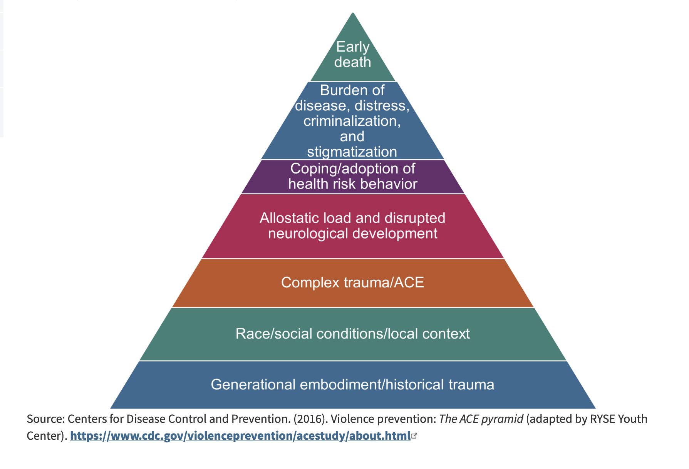
Adverse Childhood Experiences (ACE’s)
Notes:
SUBJECT MATTER: Adverse Childhood Experiences (ACE’s)
Now we are going to discuss ACEs. In your previous CAS minor courses you were introduced to the origination of ACEs, what an ACE score is, moving from ACEs to resilience, and CDC information on comorbidity with ACEs.
NOTE: READ IF STUDENTS NEED A REFRESHER OF THE FOUNDATION:
The Original ACE Study (Information about the foundational ACE study.)
The foundational ACE Study was conducted by the Centers for Disease Control and Kaiser Permanente in the mid-1990s with a group of patients insured through Kaiser Permanente. The initial study focused on how traumatic childhood events may negatively affect adult health. The 17,000 participants surveyed were asked about their experiences with childhood maltreatment, family dysfunction, and current health status and behaviors. The ACEs Pyramid on the left side of the image below represents the conceptual framework created, which illustrates how strongly ACEs are related to a person’s well-being throughout their lifespan.
The ACE study found a direct link between childhood trauma and adult onset of chronic disease, incarceration, and employment challenges. The higher the number of ACEs, the greater the incident of negative outcomes as captured in the ACE Pyramid. In 2015, the RYSE Center adapted the pyramid as seen on the right side of the image below to include two layers on the bottom that account for the role historical trauma and social location play in a person’s health outcome. This revised model aligns better with the Socio-Ecological Model and accounts for the influences of each sphere on health outcomes.
Reference:
Centers for Disease Control and Prevention. (2016). Violence Prevention: The ACE pyramid (adapted by RYSE Youth Center). https://nhttac.acf.hhs.gov/soar/eguide/stop/adverse_childhood_experiences
Image Credit: https://nhttac.acf.hhs.gov/soar/eguide/stop/adverse_childhood_experiences

Slide 16
Adverse Childhood Experiences (ACEs)
Discussion
  How might ACEs present in a group therapy session?
  What are protective factors for ACEs?
  What are risk factors for ACEs?
Notes:
SUBJECT MATTER: Adverse Childhood Experiences (ACE’s)
Let’s connect the knowledge you have now of ACE’s to the application of group process.
How might ACEs present in a group therapy session?
Answers can include: portrayal of dysfunctional family in addiction roles (THE ADDICT OR ABUSER, THE ENABLER OR CODEPENDENT, THE SCAPEGOAT OPPOSITE THE HERO, THE MASCOT, THE LOST CHILD. If family roles have not been identified by the person the roles will present in all areas of life (social, work, school, intimate partner, therapy).
What are protective factors for ACEs?
Answers can include ideas that pertain to: Connection Communication, Confidence, Competence, Commitment and Control
What are risk factors for ACEs?
Answers include: physical & emotional neglect, divorce, mental illness, incarceration, homelessness, domestic violence, substance abuse, emotional & sexual abuse, maternal depression, poverty, discrimination, community disruption, violence, poor housing/quality/affordability

Slide 17

Notes:
SUBJECT MATTER: CULTURAL CONSIDERATIONS
Next, we are going to review Cultural Considerations and how culture impacts our work as helpers.
Image Credit: Flickr

Slide 18
Ways to Overcome Implicit Bias
Introspection: Set aside time to understand your biases by taking a personal inventory of them. This can be done by taking tests to identify the biases you may have.
Mindfulness: Once you understand the biases you hold, be mindful that you’re more likely to give in to them when you’re under pressure or need to make quick decisions. If you’re feeling stressed, pause for a minute, collect yourself, and take a few deep breaths.
Notes:
SUBJECT MATTER: CULTURAL CONSIDERATIONS
Read slide
Potential Discussion Questions:
What do you do- How do you respond, when you take personal inventory and realize you hold potentially harmful implicit bias? – What is a group therapy exercise which supports making these kinds of shifts in attitude and perspective?
How do you plan to create more time to pause, breathe, and avoid making quick decisions? – What is a group therapy exercise which encourages this?
Key Points:
When we speak about the transition from the unconscious to conscious awareness, we must start with the most powerful act of consciousness which IS looking in the mirror! – Introspection is key to overcoming implicit bias
Introspection is very much an independent activity, however modeling the appropriateness and a willingness to participate in this activity, and positively rewarding group members for their engagement are powerful tools, done in the group setting.
Setting aside time, unpacking pressure and stress, and avoiding quick decision-making are challenges for most of us who have a lot on our plates and who strive for peak performance and production. Practicing these healthy habits in a group setting is helpful to create a ‘muscle memory’ of the process.
References:
The American Academy of Family Physicians (AAFP) Article: “How to Identify, Understand, and Unlearn Implicit Bias in Patient Care”. Family Practice Manager. 2019;26(4):29-33. Dr. Edgoose.
Smedley BD, Stith AY, Nelson AR, eds Unequal Treatment: Confronting Racial and Ethnic Disparities in Health Care. Washington, DC: Institute of Medicine, National Academy Press; 2003

Slide 19
Ways to Overcome Implicit Bias
Perspective-Taking: If you think you may be stereotyping people or groups, imagine what it would feel like for others to stereotype you.
Learn to Slow Down: Before jumping to conclusions about others, remind yourself of positive examples of people from their age group, class, ethnicity, or sexual orientation. This can include friends; colleagues; or public figures, such as athletes, members of the clergy, or local leaders.
Notes:
SUBJECT MATTER: CULTURAL CONSIDERATIONS
Read slide
Potential Discussion Questions:
What if the show WAS on the other foot? How would you feel if others were to stereotype you because of the ways you may be different?
What are some ways to draw upon positive examples of diverse cultural groups, if you have limited experiences with diverse cultural groups? Apply this to group therapy-
Key Points:
We’ve all heard the cliché, treat others how you want to be treated- but the Why? behind the saying is because we are constantly reshaping our identities; groups have such a power of influence in how each other reshapes the identity, so we are treating others the ways we want to be treated as a means for teaching others how we want to be treated, and group therapy empowers us to practice teaching these important points.
Group therapy is a safe space to process some of the intense feelings we experience, when bias has offended or worked against us.
Slowing down is the key! Time Management groups are appropriate spaces to practice the skill of overcoming implicit bias.
References:
The American Academy of Family Physicians (AAFP) Article: “How to Identify, Understand, and Unlearn Implicit Bias in Patient Care”. Family Practice Manager. 2019;26(4):29-33. Dr. Edgoose.
Smedley BD, Stith AY, Nelson AR, eds Unequal Treatment: Confronting Racial and Ethnic Disparities in Health Care. Washington, DC: Institute of Medicine, National Academy Press; 2003

Slide 20
Ways to Overcome Implicit Bias
Individualization: Remind yourself that all people have individual characteristics that are separate from others within their group. Focus on the things you have in common.
Check Your Messaging: Instead of telling yourself that you don’t see people based on their color, class, or sexual orientation, learn to use statements that embrace inclusivity. For example, Apple Inc.’s inclusion statement circles around the topic of being different together: “At Apple, we’re not all the same, and that’s our greatest strength.”
Notes:
SUBJECT MATTER: CULTURAL CONSIDERATIONS
Read slide
Potential Discussion Questions:
What do you do- How do you respond, when you take personal inventory and realize you hold potentially harmful implicit bias? – What is a group therapy exercise which supports making these kinds of shifts in attitude and perspective?
How do you plan to create more time to pause, breathe, and avoid making quick decisions? – What is a group therapy exercise which encourages this?
Key Points:
When we speak about the transition from the unconscious to conscious awareness, we must start with the most powerful act of consciousness which IS looking in the mirror! – Introspection is key to overcoming implicit bias
Introspection is very much an independent activity, however modeling the appropriateness and a willingness to participate in this activity, and positively rewarding group members for their engagement are powerful tools, done in the group setting.
Setting aside time, unpacking pressure and stress, and avoiding quick decision-making are challenges for most of us who have a lot on our plates and who strive for peak performance and production. Practicing these healthy habits in a group setting is helpful to create a ‘muscle memory’ of the process.
References:
The American Academy of Family Physicians (AAFP) Article: “How to Identify, Understand, and Unlearn Implicit Bias in Patient Care”. Family Practice Manager. 2019;26(4):29-33. Dr. Edgoose.
Smedley BD, Stith AY, Nelson AR, eds Unequal Treatment: Confronting Racial and Ethnic Disparities in Health Care. Washington, DC: Institute of Medicine, National Academy Press; 2003

Slide 21
Ways to Overcome Implicit Bias
Institutionalize Fairness: In the workplace, learn to embrace and support diversity.
Take Two: Overcoming unconscious biases takes time. Understand that this is a lifelong process and that deprogramming your biases requires constant mindfulness and work.
Notes:
SUBJECT MATTER: CULTURAL CONSIDERATIONS
References:
The American Academy of Family Physicians (AAFP) Article: “How to Identify, Understand, and Unlearn Implicit Bias in Patient Care”. Family Practice Manager. 2019;26(4):29-33. Dr. Edgoose.
Smedley BD, Stith AY, Nelson AR, eds Unequal Treatment: Confronting Racial and Ethnic Disparities in Health Care. Washington, DC: Institute of Medicine, National Academy Press; 2003

Slide 22
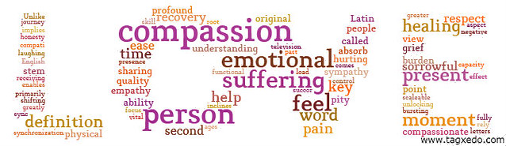
Notes:
SUBJECT MATTER: COMPASSION FATIGUE
Transition Slide: Next, we will be discussing compassion fatigue and why it is just as important to care for you as it is the people you serve.
Image Credit: www.tagxedo.com word cloud creator

Slide 23

‘Preparing to be in the behavioral health workforce requires knowledge, skills, and tools to deal with and effectively manage the occupational hazards associated with the profession.’
Bride et al., 2007, p.155
Notes:
SUBJECT MATTER: COMPASSION FATIGUE
The next two slides slides introduce the concept of the occupational hazards associated with behavioral health professions. This is a quote from the Bride article.
Reference:
Bride, B.E., Radney, M., & Figley, C.R. (2007). Measuring compassion fatigue. Clinical Social Work Journal, 35, 155-163.
IMAGE CREDIT: Shutterstock (purchased image).
Slide Credit: Pacific Southwest Addiction Technology Transfer Center Network. Compassion Fatigue and the Behavioral Health Workforce Curriculum Infusion Package. https://uclaisap.org/html2/compassion-fatigue-behavioral-workforce-cip.html

Slide 24

‘It is now widely recognized that the indirect exposure to trauma involves an inherent risk of significant emotional, cognitive, and behavioral changes in the clinician.’ Bride et al., 2007, p.155
Clinicians take in some level of their clients’ pain by:
facilitating sessions
listening to stories
collecting data as part of their efforts to intervene to identify issues
provide treatment services with kindness and empathy
Notes:
SUBJECT MATTER: COMPASSION FATIGUE
This slide illustrates how behavioral health professionals take on some of their clients’ pain. Ask students for their reactions to this and the previous slide, and process their reactions. For example, did they know that clinicians take in some level of their client’s pain?
References:
Bride, B.E., Radney, M., & Figley, C.R. (2007). Measuring compassion fatigue. Clinical Social Work Journal, 35, 155-163.
Newell, J.M., Gardell, D.N., & MacNeil, G. (2016). Clinician response to client traumas: A chronological review of constructs and terminology. Trauma, Violence, & Abuse, 17, 306-313.
IMAGE CREDIT: Shutterstock (purchased image).
Slide Credit: Pacific Southwest Addiction Technology Transfer Center Network. Compassion Fatigue and the Behavioral Health Workforce Curriculum Infusion Package. https://uclaisap.org/html2/compassion-fatigue-behavioral-workforce-cip.html

Slide 25
Just Part of the Job…
‘To work with those who are vulnerable and suffering, particularly trauma populations, inherently requires clinicians to be actively ready to use their own personal psychological resources in the form of empathy and compassion on a daily basis.
While this may seem obvious to those of us in the profession, we maintain that this ‘‘requirement of the job’’ is quite unique in comparison to other professional disciplines
In other words, the emotional requirements of clinical practice, specifically the chronic use of empathy and compassion, are simply not required as part of the essential skill set in other professions.’
Newell, 2016, p.310
Notes:
SUBJECT MATTER: COMPASSION FATIGUE
This slide highlights the point that, unlike other professions, behavioral health professionals and health care providers are required to use their ‘own personal psychological resources’, like kindness and empathy, to do their job. The phrase just part of the job does not adequately explain the clinical demands or the impact of hearing traumatic stories. This slide is a direct quote from Newell and colleagues article and should be noted by the instructor. The authors of this CIP recommend this article, as it provides one of the best overviews of compassion fatigue.
Reference:
Newell, J.M., Gardell, D.N., & MacNeil, G. (2016). Clinician response to client traumas: A chronological review of constructs and terminology. Trauma, Violence, & Abuse, 17, 306-313.
Slide Credit: Pacific Southwest Addiction Technology Transfer Center Network. Compassion Fatigue and the Behavioral Health Workforce Curriculum Infusion Package. https://uclaisap.org/html2/compassion-fatigue-behavioral-workforce-cip.html

Slide 26
These emotional requirements of clinical practice can lead to:
  vicarious traumatization (VT)
  secondary traumatic stress (STS)
  compassion fatigue (CF)
* supported by a growing body of empirical research
Adams, Boscarino, & Figley, 2006; Bride, 2004, 2007
Notes:
SUBJECT MATTER: COMPASSION FATIGUE
Currently, the demands of clinical practice can place behavioral health professionals and health care providers at risk to several occupational hazards/conditions of varying severity. The definitions of these stress and trauma related conditions are defined and discussed in the next four slides.
References:
Adams, R.E., Boscarino, J.A.,& Figley, C.R. (2006). Compassion fatigue and psychological distress among social workers: A validation study. American Journal of Orthopsychiatry, 76, 103-108.
Bride, B.E. (2004). The impact of providing psychosocial services to traumatized populations. Stress, Trauma, and Crisis: An International Journal, 7, 1-18.
Bride, B.E. (2007). Secondary traumatic stress among social workers. Social Work, 52, 63-70.
Bride, B.E., Radney, M., & Figley, C.R. (2007). Measuring compassion fatigue. Clinical Social Work Journal, 35, 155-163.
Slide Credit: Pacific Southwest Addiction Technology Transfer Center Network. Compassion Fatigue and the Behavioral Health Workforce Curriculum Infusion Package. https://uclaisap.org/html2/compassion-fatigue-behavioral-workforce-cip.html

Slide 27
Discussion
How can challenging clientele impact compassion fatigue in a substance use counselor/case manager?
How do we separate personal life from professional life (i.e. divorce, your recovery, thinking of clients outside of work, birth, death, relapse, etc.)?
Notes:
SUBJECT MATTER: COMPASSION FATIGUE
Discussion:
Use these questions to generate class participation and connection of compassion fatigue to their life.
The purpose is to have students gain an awareness of compassion fatigue, the impact it has on our professional life, and how our own personal stressors can impact our work.

Slide 28

Resources
Suicide Prevention:
Zero Suicide Institute
Zero Suicide Listserv
NV Office for Suicide Prevention
NV Zero Suicide Initiative
The Lifeline and 988
UNR LiveWell Resource Page
Notes:
Resources are provided and should assist in maintaining important referral agencies/support services as well as resources for students.
Zero Suicide Institute: https://zerosuicideinstitute.com/
Zero Suicide Listserv: https://zerosuicide.edc.org/movement/zero-suicide-listserv
NV Office for Suicide Prevention: http://suicideprevention.nv.gov/
NV Zero Suicide Initiative: https://nvopioidresponse.org/initiatives/zs/
The Lifeline and 988: https://988lifeline.org/current-events/the-lifeline-and-988
UNR LiveWell Resource Page: https://www.unr.edu/livewell
Image Credit: SAMHSA 988 Partner Toolkit

Slide 29
Resources
Community Resources:
UNR Disabilities Resource Center
Nevada Center for Excellence in Disabilities Directory
CASAT on Demand Resources & Downloads
Pacific Southwest Addiction Technology Transfer Center (PSATTC)
The Mental Health Technology Transfer Center Network
The Prevention Technology Transfer Center Network
Dep. of Health & Human Services Aging and Disability Services Division
SAMHSA’s Technology Transfer Center (TTC) Programs
Notes:
Resources are provided and should assist in maintaining important referral agencies/support services as well as resources for students.
Community Resources:
UNR Disabilities Resource Center: https://www.unr.edu/drc
Nevada Center for Excellence in Disabilities Directory: https://www.unr.edu/education/faculty-and-staff/nevada-center-for-excellence-in-disabilities
CASAT on Demand Resources & Downloads: https://casatondemand.org/resources_downloads/
Pacific Southwest Addiction Technology Transfer Center (PSATTC): https://attcnetwork.org/centers/pacific-southwest-attc/home
The Mental Health Technology Transfer Center Network: https://mhttcnetwork.org/
The Prevention Technology Transfer Center Network: https://pttcnetwork.org/
Department of Health & Human Services Aging and Disability Services Division: https://adsd.nv.gov/
SAMHSA’s Technology Transfer Centers (TTC) Programs: techtransfercenters.org

Slide 30
Notes:
The Pathways in Crisis Services (PICS) Project provides academic course and professional learning events and content focused on evidence-based crisis programs that include crisis intervention, de-escalation services, mobile crisis and crisis stabilization for Pre-service (students) and Practicing Behavioral Health Professionals with the goal of increasing knowledge and skills leading to use in practice.
This is accomplished by guaranteeing students get exposed to crisis intervention services and skills while in school in order to prepare them to do crisis intervention services which includes: risk determination; early intervention; de-escalation strategies; how to conduct warm-hand-off; and understanding the new (988) system through the development of curriculum infusion and training. Practicing Professionals will have the opportunity to attend a variety of training and technical assistance (T/TA) events to ensure that T/TA in crisis-based programs is available to help prepare these professionals with the knowledge and skills to provide crisis-based services.
This project was supported in whole or in part by the Nevada Division of Public and Behavioral Health Bureau of Behavioral Health, Prevention, and Wellness. The opinions, findings, conclusions and recommendations expressed in this publication are those of the author(s) and do not necessarily represent the official views of the State of Nevada or CASAT.

