Slide 1
Pathways in Crisis Services Project
Center for the Application of Substance Abuse Technologies (CASAT)
CAS 354: Screening and Client Engagement
Notes:
Pathways to Crisis Services (PICS) Curriculum Infusion Packages (CIPs) are a product for educators and trainers developed by the Center for the Application of Substance Abuse Technologies (CASAT). The main developers of crisis services materials are April Lang-Barroga, LMFT, LCADC, NCC and Bianca D. McCall, LMFT. Additional guidance and editing support were provided by, Terra Hamblin, MA, NCC, BC-TMH and Sophia Graham, BS.
This product was developed to help community college/university faculty, as well as clinical supervisors and recovery support staff have access to brief, science-based content to provide materials that can be easily infused into existing substance use disorder and related courses (e.g., social work, nursing, criminal justice, foundation of addiction courses, ethics, counseling courses, etc.). Individuals can select the specific content to infuse into existing curricula/materials depending on the specific needs of their learners. Each slide in the slide decks contains notes to provide guidance on the topics along with references and handouts where appropriate. If you require further information, please do not hesitate to contact the CASATs PICS Project Staff located at CASAT (775-784-6265).
You are free to use these slides and pictures, but please give credit to PICS when using them by referencing the PICS Program at the beginning of your presentation.
Funding for this product/publication was made possible in whole or in part by the Nevada Division of Public and Behavioral Health Bureau of Behavioral Health, Prevention, and Wellness (DHHS). The views expressed in these materials do not necessarily reflect the official policies or views of DHHS or the State of Nevada nor does mention of trade names, commercial practices, or organizations imply endorsement by the U.S. Government or the State.
Additional resources are available to enhance and support the information provided in this brief presentation.
Date last updated: January 2023

Slide 2
Curriculum Infusion Introduction
Notes:
This module was developed for the University of Nevada, Reno’s CAS 354 Screening and Client Engagement 3 credit undergraduate course. This course provides an overview of philosophical and procedural components for providing addictions services; professional characteristics, ethical/legal issues, helping process and initial assessment. Motivational interviewing practiced.
Sources:
Center for the Application of Substance Abuse Technologies (CASAT) Academics: https://casat.org/academic/
UNR Course Descriptions:
https://catalog.unr.edu/content.php?catoid=45&catoid=45&navoid=47663&filter%5Bitem_type%5D=3&filter%5Bonly_active%5D=1&filter%5B3%5D=1&filter%5Bcpage%5D=9

Slide 3



Topics
Crisis Response System
Suicide Prevention
Trauma
Cultural Considerations
Compassion Fatigue
Notes:
Read slide to review topics that will be covered.
Image Credit:
Emergency Image Credit: Picpedia
Man with Head in Hands Image Credit: PxHere
Woman Image Credit: Wikimedia Commons

Slide 4
Disclaimer
This presentation may include readings, media, and discussion around topics such as suicide, trauma, and crisis intervention and may be difficult.
Please listen to yourself… and reach out if you are having difficulty with these topics.
Notes:
Read Disclaimer: This presentation may include readings, media, and discussion around topics such as suicide, trauma, and crisis intervention and may be difficult.
In addition, it is recommended and encourage for you to care for your safety and well-being. If this topic and conversation elevates you, please reach out to someone and seek help immediately.

Slide 5
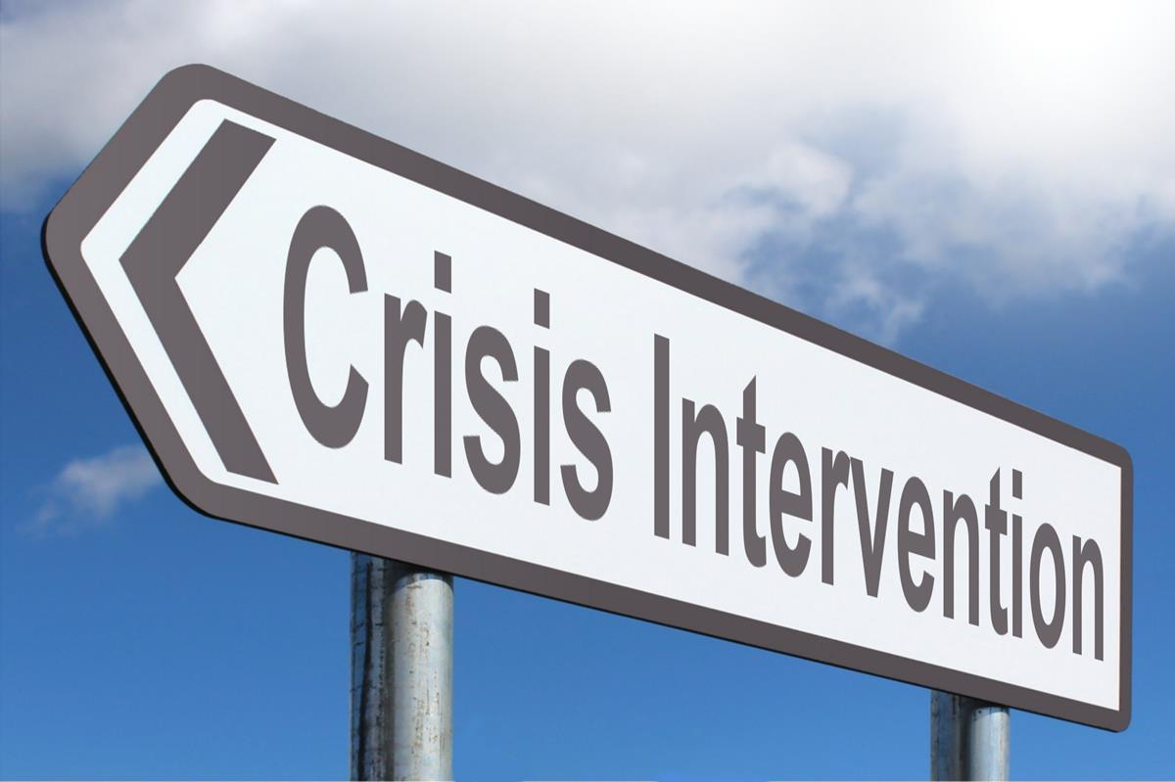
Notes:
SUBJECT MATTER: CRISIS RESPONSE SYSTEM
Transition slide: Inform students we will be covering Crisis Response System information. This will build upon PICS material from your previous CAS minor courses.
The crisis continuum includes various crisis services for individuals with urgent behavioral health needs, and the response to such crises and pathways toward a more complete assessment and treatment when needed.
Image: Picpedia

Slide 6
Phases of Disaster Response & Grief Cycles
Graph Source: Graph from Samsha.gov. adapted from Zunin and Myers
Notes:
SUBJECT MATTER: CRISIS RESPONSE SYSTEM
Assuming students completed CAS 254 and 255, READ: In CAS 254 you reviewed the National Guidelines for Behavioral Health Crisis Services and the Crisis Services in Alignment image. Remember that in a given crisis system 80% of mental health crises can be resolved by phone!! CAS 255 you reviewed the Crisis Response Systems in Nevada that include: call centers (crisis support services), 24/7 mobile crisis (mobile crisis response team (youth and families) and mobile outreach safety teams (attached to local law enforcement), crisis stabilization programs (2 in Las Vegas, 1 in Reno), and the essential principles and practices (trauma-informed care, suicide safer care, peer to peer support). You also reviewed Nevada’s Crisis Continuum and the problems we have seen with crisis response systems across the nation.
In relation to this course, we are going to discuss the phases of disaster response and grief.
There are 6 phases of disaster response- to be considered for any crisis response system in addition to understanding the emotional highs and lows we will experience throughout the course of a crisis.
Crisis responses services should be sustainable and suitable for a marathon and not a sprint. The 6 phases are as follows:
Pre-Disaster where the responsibility of the CRS is to provide warning of the threat and prevention is also done at this time
The Impact of the threat
A Heroic Response from first responders and the community
The Honeymoon is when the community comes together in solidarity
Then we experience Disillusionment when inventory and resources are exhausted and activating events for trauma brains, leaving us to our vices or coping strategies
As we rise again, during the Reconstruction phase- rising to the occasion of The New Normal
Grief is any situation where there is an actual or perceived loss. It is important to understand there are different types of grief and rather than cycles per se- we are looking at specific tasks of grief. A lot of us are familiar with the traditional but linear stages of grief model by Kessler (Finding Meaning: The Sixth Stage of Grief David Kessler)- which proposes we all experience stages of denial, anger, bargaining, depression, and eventually acceptance. This model was based on what is called anticipatory grief… someone falls ill or is getting older and we expect the end of life, as a natural part of the life span. But this doesn’t necessarily apply to more complicated grief, like an unexpected and significant loss of a loved one, loss of a person- even speaking to the loss of our person meaning our identities. How many of us lost our identities as working people, heads of households, full time parents, community educators, etc.? The pandemic certainly caused what I would call complicated grief which forces us to consider our grief experiences differently. Because the problem is we can sometimes experience relapse in any of those stages because we are frustrated and we can’t seem to figure out how to get to ‘acceptance’ right? Just accept the loss and move on- There are newer more fluid models which explains our individual processes of grief.
Four steps of mourning
William Morton suggests we all experience 4 Tasks of Mourning and I’m going to give examples of the grief being a death; those tasks are:
Understand reality of the death
Allow the feelings and thoughts of grief
Reinvest in life/meaning in life
Keep an enduring connection with loved one after death;
In addition to previously mentioned models, there is the Dual Process Model by Stoby and Strutt. This model suggests we experience Loss Orientation and Restoration Orientation. Prior to the 1950’s we experienced the end of life in the home, then the hospital systems and hospice removed death from occurring in the home and that sort of disconnected us from the concept and more significantly, the conversation about death in our homes and with our families.
Discussion: How might this information be important when forming a group? When supporting people in a group?
Image Credit: Graph from Samsha.gov. adapted from Zunin and Myers
Reference(s):

Slide 7
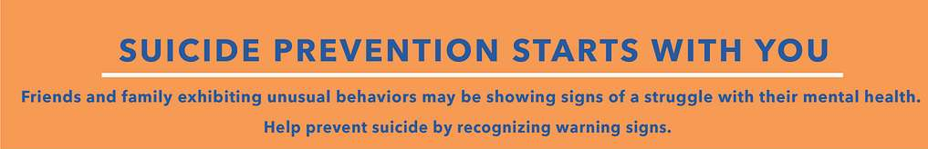
Notes:
SUBJECT MATTER: SUICIDE PREVENTION
READ: Inform students we will be reviewing suicide prevention risk and protective factors, suicide risk assessments, and how to work with someone who is suicidal. Please be aware of how you are responding to the material and how you might have discussions of suicide with your clientele. Suicide is a difficult topic to learn about and experience. Please be considerate of your students when they are sharing.
Image Credit: Picryl

Slide 8
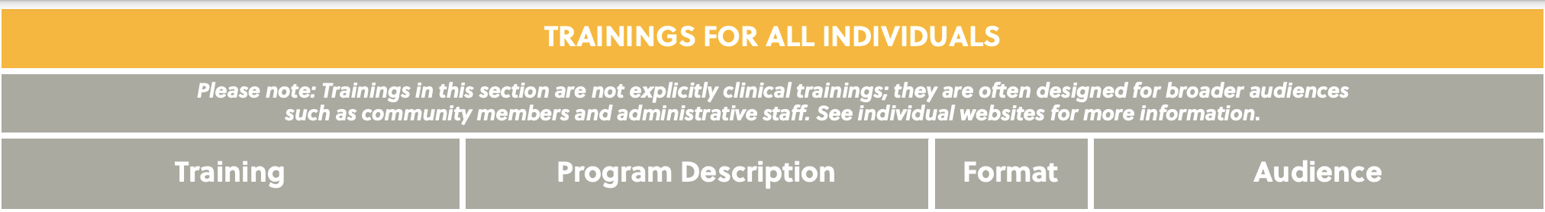
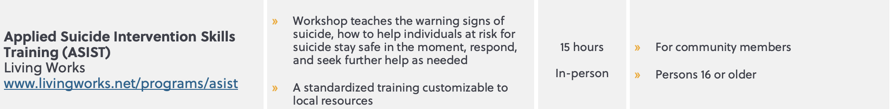
Suicide Safer Care Training
Notes:
SUBJECT MATTER: SUICIDE PREVENTION
Read slide: this graph speaks to ASIST (Applied Suicide Intervention Skills Training) training, how long it takes, what it reviews, and who it is designed for.
Knowledge of suicide prevention/intervention training allows all people helping others to have a foundation in how to best help in a crisis.
Image Credit: Suicide Care Training Options located on https://zerosuicide.edc.org/sites/default/files/2020-11/2020.11.18%20Suicide%20Care%20Training%20Options_0.pdf
Reference: Zero Suicide 2016 Education Development Center

Slide 9
Counseling on Access to Lethal Means
(CALM)
Reducing access to lethal means is an evidence-based strategy for suicide prevention.
Reducing access to lethal means, such as firearms and medication, can determine whether a person
Advise clients on specific off-site and in-home secure storage options for firearms and strategies to limit access to dangerous medications.
Work with your clients and their families to develop a specific plan to reduce access to lethal means and follow up on the plan over time.
CALM is a free, self-paced, online course for health care and social services providers.
Notes:
SUBJECT MATTER: SUICIDE PREVENTION
READ slide. This slide reviews CALM - Counseling on Access to Lethal Means
The CALM course:
Reducing access to lethal means is an evidence-based strategy for suicide prevention.
Reducing access to lethal means, such as firearms and medication, can determine whether a person
Advise clients on specific off-site and in-home secure storage options for firearms and strategies to limit access to dangerous medications.
Work with your clients and their families to develop a specific plan to reduce access to lethal means and follow up on the plan over time.
Reference:
CALM: Counseling on Access to Lethal Means | Suicide Prevention Resource Center. (2018). https://www.sprc.org/resources-programs/calm-counseling-access-lethal-means​
Link to CALM course description: https://zerosuicidetraining.edc.org/enrol/index.php?id=20​

Slide 10

Treat: Suicide-Specific Brief Interventions: David Jobes
Source: Zero Suicide Institute
Notes:
SUBJECT MATTER: SUICIDE PREVENTION
WATCH: Suicide Specific Brief Interventions https://youtu.be/jwkJ50EY0jQ (3:34)
In this brief video, David Jobes, PhD, professor of psychology at Catholic University, describes four evidence-based brief interventions for people who have attempted or at risk for suicide.
DISCUSSION: How will your knowledge of TMBI (Teachable Moment Brief Intervention) be utilized with a client who has attempted suicide?

Slide 11
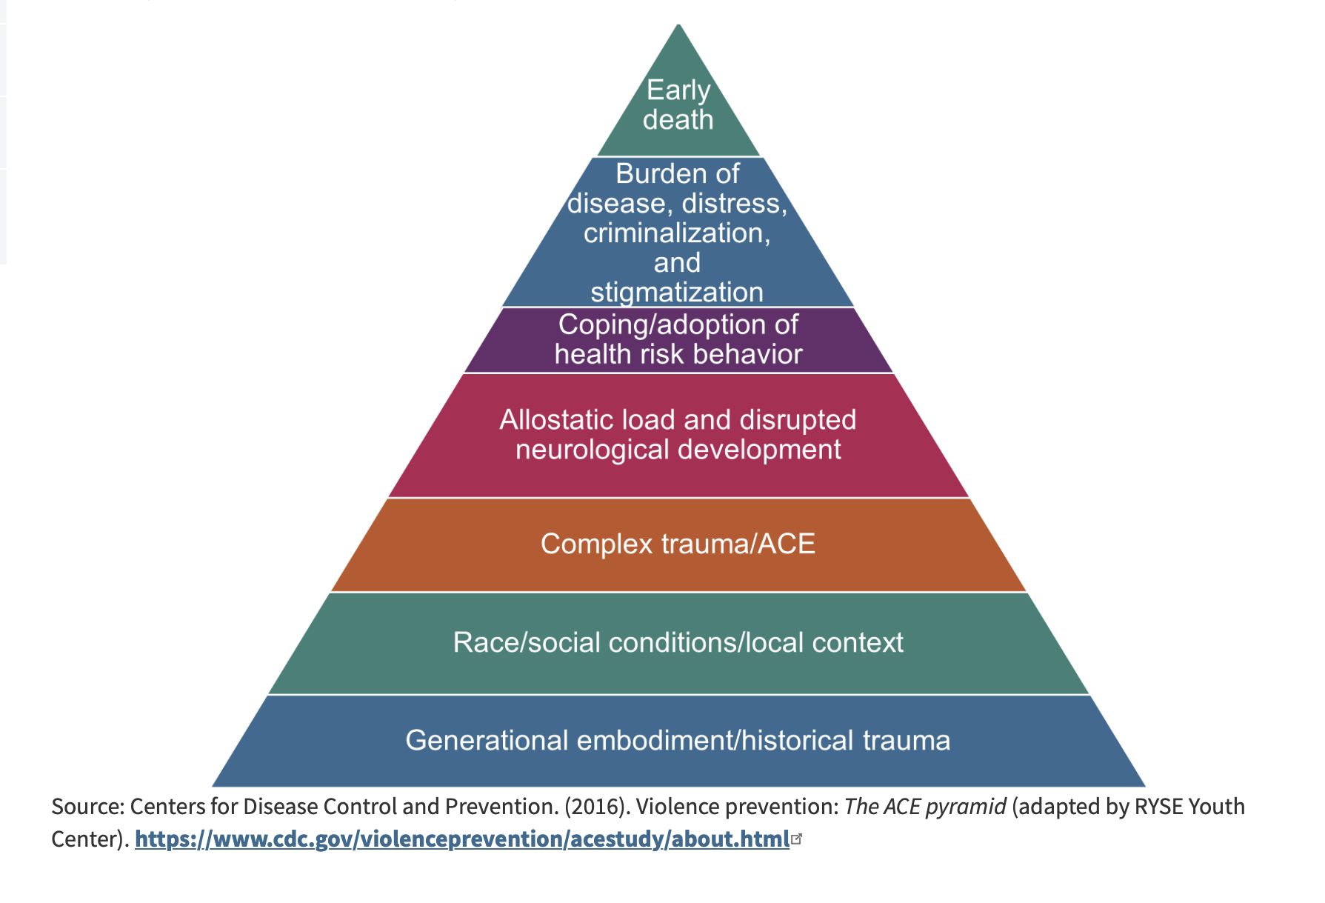
Adverse Childhood Experiences (ACE’s)
Notes:
SUBJECT MATTER: Adverse Childhood Experiences (ACEs)
Information about the foundational ACE study.
READ: Now we are going to discuss Adverse Childhood Experiences (ACEs). In your previous CAS minor courses you were introduced to the origination of ACE’s, what an ACE score is, moving from ACE’s to resilience, and CDC information on comorbidity with ACE’s.
READ IF STUDENTS NEED A REFRESHER OF THE FOUNDATION:
The Original ACE Study
The foundational ACE Study was conducted by the Centers for Disease Control and Kaiser Permanente in the mid-1990s with a group of patients insured through Kaiser Permanente. The initial study focused on how traumatic childhood events may negatively affect adult health. The 17,000 participants surveyed were asked about their experiences with childhood maltreatment, family dysfunction, and current health status and behaviors. The ACEs Pyramid on the left side of the image below represents the conceptual framework created, which illustrates how strongly ACEs are related to a person’s well-being throughout their lifespan.
The ACE study found a direct link between childhood trauma and adult onset of chronic disease, incarceration, and employment challenges. The higher the number of ACEs, the greater the incidence of negative outcomes as captured in the ACE Pyramid. In 2015, the RYSE Center adapted the pyramid as seen on the right side of the image below to include two layers on the bottom that account for the role historical trauma and social location play in a person’s health outcome. This revised model aligns better with the Socio-Ecological Model and accounts for the influences of each sphere on health outcomes.
Reference: https://nhttac.acf.hhs.gov/soar/eguide/stop/adverse_childhood_experiences
Image Credit: https://nhttac.acf.hhs.gov/soar/eguide/stop/adverse_childhood_experiences

Slide 12

Moving from ACEs to Resilience
Notes:
SUBJECT MATTER: Adverse Childhood Experiences (ACEs)
A Study completed by The Kaiser Foundation identifies the impact of Adverse Childhood Experiences, on behavioral health effects, mental health, and physical health including premature death metrics.
ACES are defined as;
Traumatic Events Occurs From 0 To 17 Years (61% of those surveyed experienced 4 or more ACEs)
Violence, Abuse, Neglect, Suicide, Substance Use Disorder (SUD), Mental Health, Instability, Separation, Incarceration
Impact On Future Violence Victimization And Perpetration
Lifelong Health and Opportunity
Let’s watch this film portrayed by young males who discuss their ACEs and resiliency.
[WATCH video]: Youtube: Moving from ACEs to Resilience https://youtu.be/-pnhFmdz-ig (5:33 minutes)
DISCUSSION:
How do we begin the conversation of resiliency with our clients?
Answers include: inquire about strengths, what has worked well for the client with past adversities, assess healthy coping skills already in place, identifying interpersonal skills that promote resilience
What factors promote resiliency?
Answers can include ideas that pertain to: Connection Communication, Confidence, Competence, Commitment and Control (the next slide will elaborate on the 5 Factors that Promote Resiliency.)

Slide 13
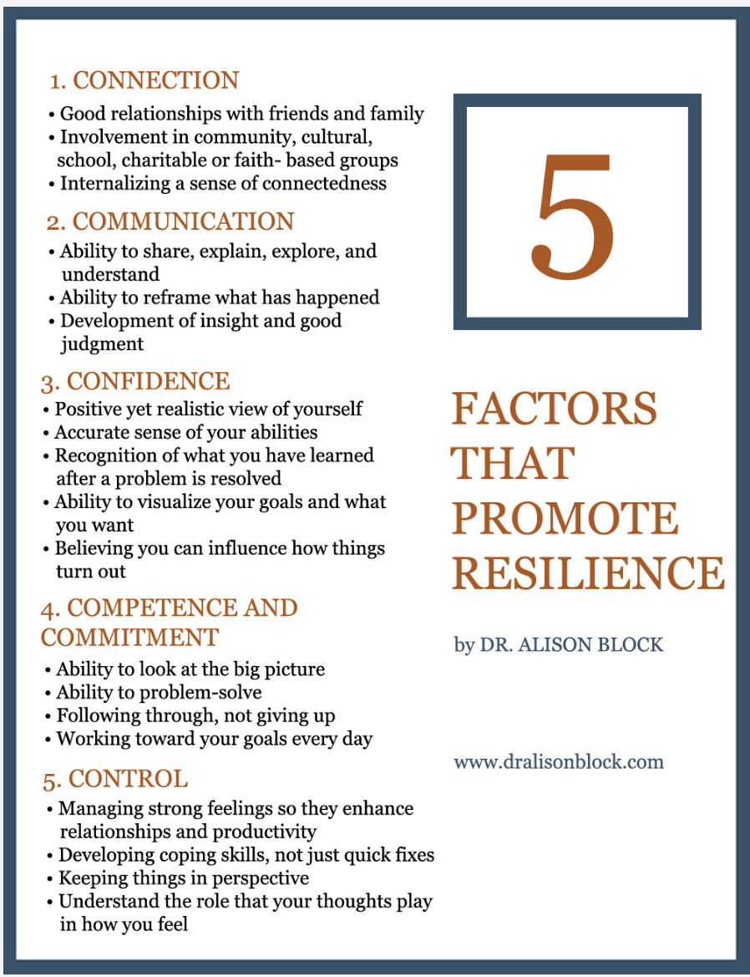
Notes:
SUBJECT MATTER: Adverse Childhood Experiences (ACEs)
Let’s look at 5 Factors that Promote Resilience.
READ slide.
Discussion:
Which area of resilience would you like to direct more attention to?
What is your strength when looking at the factors of resilience?
Image Reference:
Block, A.B. 5 FACTORS THAT PROMOTE RESILIENCE, 2023. www.dralisonblock.com

Slide 14
Trauma
Notes:
SUBJECT MATTER: TRAUMA
The following section will be an overview of trauma and how it impacts a person.

Slide 15

ReMoved
Notes:
SUBJECT MATTER: TRAUMA
Let’s take a look at this video that talks about the impact of Addiction from the viewpoint of kids who lived and experienced it. Originally created for the 168 Film Festival, ReMoved follows the emotional story through the eyes of a young girl taken from her home and placed into foster care.
******WARNING: This video depicts violence, addiction and how the trauma impacts a child. Please also note that if there is ever a point where the information shared is an activation for intense and overwhelming thoughts and feelings- there are supports ready to help.
[Play video]
ReMoved (12:47 minutes) Youtube: https://youtu.be/lOeQUwdAjE0
Discussion Topics:
How can the emotional, physical, & spiritual pain a child experiences contribute to a persons addiction?
Internal resources vary person to person. How does a person access their own resilience?

Slide 16

Notes:
SUBJECT MATTER: CULTURAL CONSIDERATIONS
Transition slide: Next we are going to review Cultural Considerations and how culture impacts our work as helpers in the substance use disorders workforce.
Image: Flickr

Slide 17

African American Mental Health
Notes:
SUBJECT MATTER: CULTURAL CONSIDERATIONS
WATCH VIDEO: How to Provide Better Care to African American Patients (3:40) https://youtu.be/YYQoYX_1AkA
Steven Starks, M.D., is the representative to the Assembly for the APA Caucus of Black Psychiatrists. He is a geriatric psychiatrist and clinical assistant professor at the University of Houston College of Medicine, discusses the mental health needs of African American patients.
Reference:
Black and African American Communities and Mental Health. (n.d.). Mental Health America. https://www.mhanational.org/issues/black-and-african-american-communities-and-mental-health

Slide 18

Asian American Mental Health
Notes:
SUBJECT MATTER: CULTURAL CONSIDERATIONS
WATCH VIDEO: Linh An Asian Hate and Mental Health. (4:17) https://youtu.be/-58rTGsq6zc
The language of the American mental healthcare system is English, which automatically casts away people who don’t speak the language. When examining its racism, a culture competent health care system needs to serve everyone. For more: https://worldchannel.org/collection/decolonizing-mental-health/
Resource:
Asian American / Pacific Islander Communities and Mental Health. (n.d.). Mental Health America. https://www.mhanational.org/issues/asian-american-pacific-islander-communities-and-mental-health

Slide 19
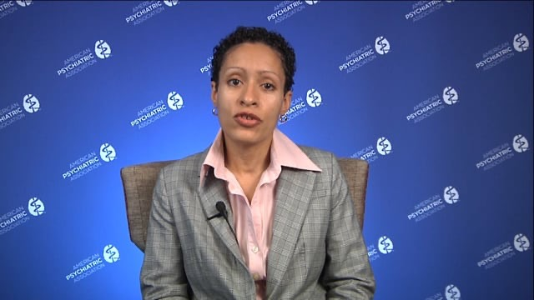
Latino Mental Health
Notes:
SUBJECT MATTER: CULTURAL CONSIDERATIONS
WATCH VIDEO: Best Practice Highlights for Working with Latino/a Patients (5:29) https://vimeo.com/152625229
Reference:
Fortuna, L. (n.d.). Best Practice Highlights Latino/as and Hispanics. American Psychiatric Association. https://www.psychiatry.org/File%20Library/Psychiatrists/Cultural-Competency/Treating-Diverse-Populations/Best-Practices-Latinos-Patients.pdf

Slide 20
LGBTQIA+ Mental Health
who struggle with higher rates of anxiety, affective disorder related conditions, and substance use disorders most likely experienced stigma and the coming out and self-acceptance process.
have a nearly three-time higher risk of suicide or suicidal behavior.
face disparities in the physical medical context, including increased tobacco use, HIV and AIDS, and weight-related problems.
greater risk for discrimination, verbal abuse, physical assaults and violence, and perhaps even childhood sexual abuse.”
Notes:
SUBJECT MATTER: CULTURAL CONSIDERATIONS
READ
“LGBTQIA+ persons who struggle with higher rates of anxiety, affective disorder related conditions, and substance use disorders most likely have struggled with stigma and the coming out and self-acceptance process. Alarmingly, LGBTQIA+ people also have a nearly three-time higher risk of suicide or suicidal behavior. LGBTQIA+ people also face disparities in the physical medical context, including increased tobacco use, HIV and AIDS, and weight-related problems.
LGBTQIA+ people are also at greater risk for discrimination, verbal abuse, physical assaults and violence, and perhaps even childhood sexual abuse.”
Reference:
Cabaj, R. (n.d.). Best Practice Highlights Lesbian, Gay, Bisexual, Transgender and people who may be questioning their sexual orientation or sexual identity (LGBTQ). American Psychiatric Association. https://www.psychiatry.org/File%20Library/Psychiatrists/Cultural-Competency/Treating-Diverse-Populations/Best-Practices-LGBTQ-Patients.PDF

Slide 21
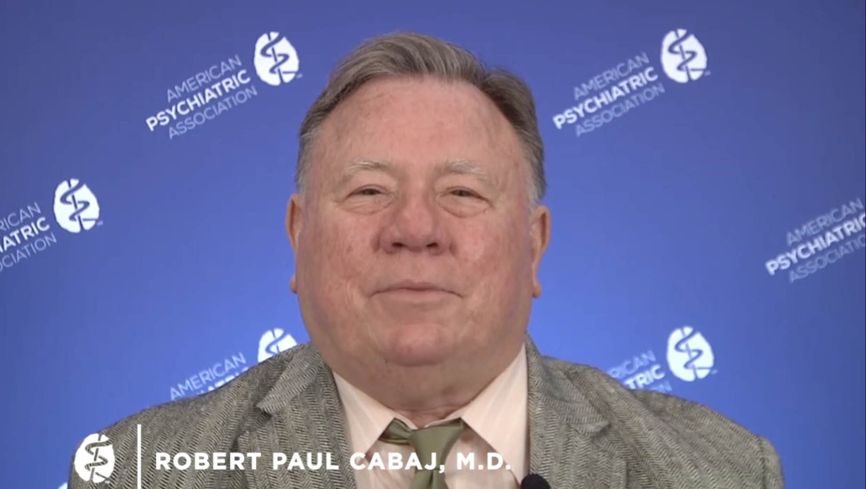
LGBTQIA+ Mental Health
Notes:
SUBJECT MATTER: CULTURAL CONSIDERATIONS
WATCH VIDEO: Best Practice Highlights for Working with LGBTQ Patients. (6:35) https://vimeo.com/152624959
Reference:
Cabaj, R. (n.d.). Best Practice Highlights Lesbian, Gay, Bisexual, Transgender and people who may be questioning their sexual orientation or sexual identity (LGBTQ). American Psychiatric Association. https://www.psychiatry.org/File%20Library/Psychiatrists/Cultural-Competency/Treating-Diverse-Populations/Best-Practices-LGBTQ-Patients.PDF

Slide 22
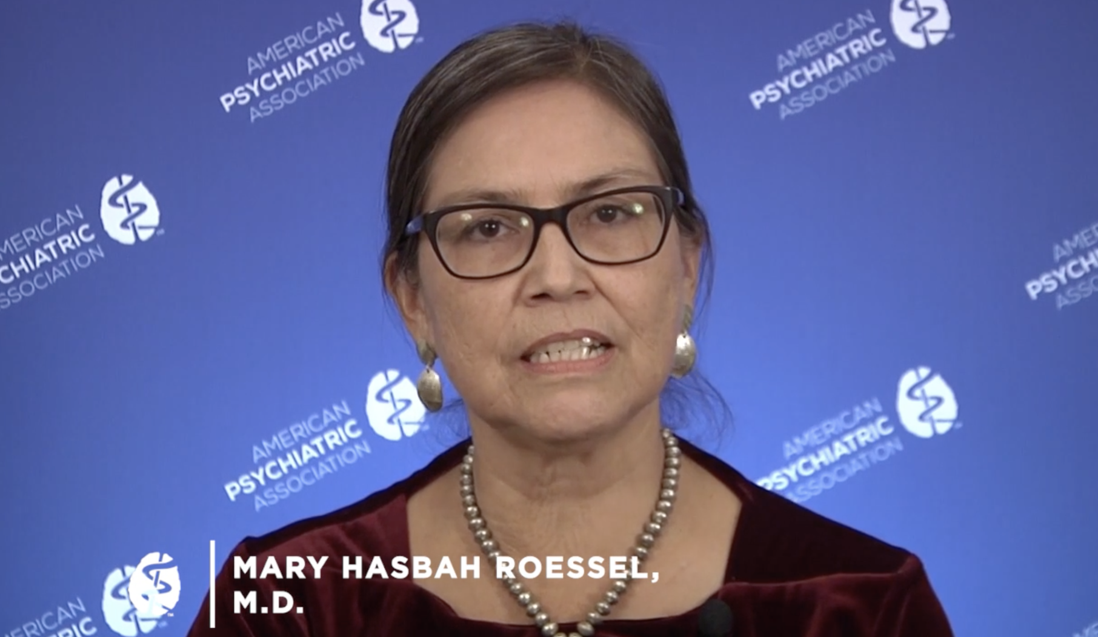
Indigenous Mental Health
Notes:
SUBJECT MATTER: CULTURAL CONSIDERATIONS
WATCH VIDEO: Best Practice Highlights for Working with Native American Patients. (8:22) https://vimeo.com/152625891
Reference:
Roessel, M. (n.d.). Best Practice Highlights Indigenous/Native American Patients. American Psychiatric Association. https://www.psychiatry.org/File%20Library/Psychiatrists/Cultural-Competency/Treating-Diverse-Populations/Best-Practices-NativeAmericans-Patients.pdf

Slide 23
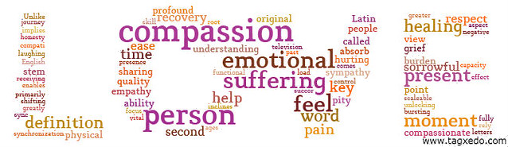
Notes:
SUBJECT MATTER: COMPASSION FATIGUE
Transition slide: Moving on to compassion fatigue.

Slide 24
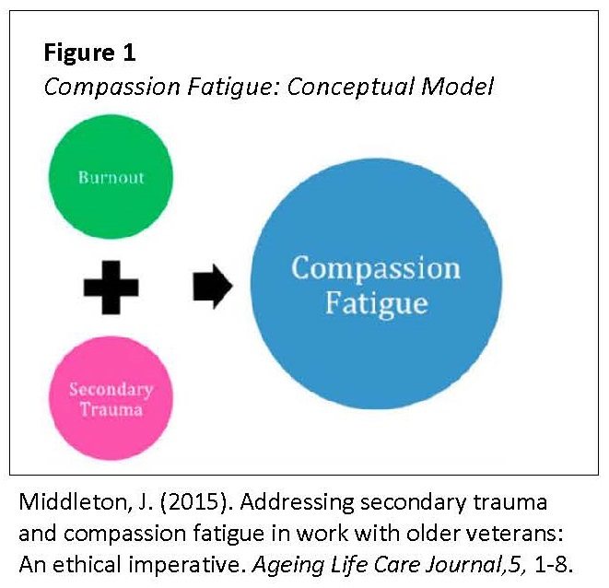
Empathy Based Stress
Notes:
SUBJECT MATTER: COMPASSION FATIGUE
Let’s take a look at Empathy Based Stress that can show as Compassion Fatigue.
First let's begin by learning what Compassion Satisfaction is.
Compassion satisfaction is about the pleasure you get from being able to do your work well.
For example, you may feel like it is a pleasure to help others through your work. You may feel positively about your colleagues or your ability to contribute to the work setting or even the greater good of society.
Reference:
Middleton, J. (2015). Addressing secondary trauma and compassion fatigue in work with older veterans: An ethical imperative. Ageing Life Care Journal, 5, 1-8.

Slide 25
Compassion fatigue is a serious problem that can undermine a person’s mental and physical health and negatively affect their relationship and ability to care for others. (Cocker & Joss, 2016)
Notes:
SUBJECT MATTER: COMPASSION FATIGUE
Read slide
Reference: Cocker, F., & Joss, N. (2016). Compassion Fatigue among Healthcare, Emergency and Community Service Workers: A Systematic Review. International journal of environmental research and public health, 13(6), 618. https://doi.org/10.3390/ijerph13060618​​

Slide 26
24 Compassion Fatigue Symptoms: | (Cocker & Joss, 2016; Clay, 2020; Stamm, 2010)
Diminished ability or interest to care for others | Feeling like a failure as a helper
Preoccupation with people you help | Drops in Productivity
Mental and/or physical exhaustion | Emotional numbness
Anger and irritability | Trouble separating personal and personal life
Anxiety and/or depression | A decreased capacity to experience sympathy and empathy
Intrusive Thoughts | Dysfunctional coping behaviors (i.e. misusing alcohol or drugs)
Sleep problems | Taking more time off work
Being easily startled | Reduced decision-making ability
Hopelessness about helping work | Feeling disconnected
Flashbacks | Decreased satisfaction or enjoyment with work
Hypervigilance
Avoidance of certain activities, situations or people you help
Notes:
SUBJECT MATTER: COMPASSION FATIGUE
This slide is an overview of Compassion Fatigue Symptoms.
READ slide to students. Propose a discussion with the students about what would their warning signs include if/when they reach compassion fatigue.
Reference:
Brown, H., PhD. (2022, October 4). What Is Compassion Fatigue? 24 Causes & Symptoms Explained. PositivePsychology.com. https://positivepsychology.com/compassion-fatigue/

Slide 27
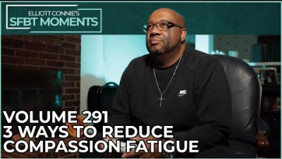
3 Ways to Reduce Compassion Fatigue
Notes:
SUBJECT MATTER: COMPASSION FATIGUE
This video introduces 3 ways to reduce compassion fatigue for helpers.
[WATCH video]
Youtube: https://youtu.be/8jJqOp1EvA8 (6:03 minutes)
Discussion:
How will you know if your job is contributing to compassion fatigue?
What hobbies keep you feeling pleasure and disconnect from your work?
Reference: 3 Ways To Reduce Compassion Fatigue | Solution Focused Universe, May 8, 2022, SFBT Moments Volume 291. https://www.youtube.com/watch?v=8jJqOp1EvA8

Slide 28
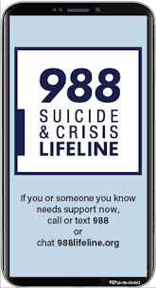
Resources
Suicide Prevention:
Zero Suicide Institute
Zero Suicide Listserv
NV Office for Suicide Prevention
NV Zero Suicide Initiative
The Lifeline and 988
UNR LiveWell Resource Page
Notes:
Resources are provided and should assist in maintaining important referral agencies/support services as well as resources for students.
Zero Suicide Institute: https://zerosuicideinstitute.com/
Zero Suicide Listserv: https://zerosuicide.edc.org/movement/zero-suicide-listserv
NV Office for Suicide Prevention: http://suicideprevention.nv.gov/
NV Zero Suicide Initiative: https://nvopioidresponse.org/initiatives/zs/
The Lifeline and 988: https://988lifeline.org/current-events/the-lifeline-and-988
UNR LiveWell Resource Page: https://www.unr.edu/livewell
Image Credit: SAMHSA 988 Partner Toolkit

Slide 29
Resources
Community Resources:
UNR Disabilities Resource Center
Nevada Center for Excellence in Disabilities Directory
CASAT on Demand Resources & Downloads
Pacific Southwest Addiction Technology Transfer Center (PSATTC)
The Mental Health Technology Transfer Center Network
The Prevention Technology Transfer Center Network
Dep. of Health & Human Services Aging and Disability Services Division
SAMHSA’s Technology Transfer Center (TTC) Programs
Notes:
Resources are provided and should assist in maintaining important referral agencies/support services as well as resources for students.
Community Resources:
UNR Disabilities Resource Center: https://www.unr.edu/drc
Nevada Center for Excellence in Disabilities Directory: https://www.unr.edu/education/faculty-and-staff/nevada-center-for-excellence-in-disabilities
CASAT on Demand Resources & Downloads: https://casatondemand.org/resources_downloads/
Pacific Southwest Addiction Technology Transfer Center (PSATTC): https://attcnetwork.org/centers/pacific-southwest-attc/home
The Mental Health Technology Transfer Center Network: https://mhttcnetwork.org/
The Prevention Technology Transfer Center Network: https://pttcnetwork.org/
Department of Health & Human Services Aging and Disability Services Division: https://adsd.nv.gov/
SAMHSA’s Technology Transfer Centers (TTC) Programs: techtransfercenters.org

Slide 30
Notes:
The Pathways in Crisis Services (PICS) Project provides academic course and professional learning events and content focused on evidence-based crisis programs that include crisis intervention, de-escalation services, mobile crisis and crisis stabilization for Pre-service (students) and Practicing Behavioral Health Professionals with the goal of increasing knowledge and skills leading to use in practice.
This is accomplished by guaranteeing students get exposed to crisis intervention services and skills while in school in order to prepare them to do crisis intervention services which includes: risk determination; early intervention; de-escalation strategies; how to conduct warm-hand-off; and understanding the new (988) system through the development of curriculum infusion and training. Practicing Professionals will have the opportunity to attend a variety of training and technical assistance (T/TA) events to ensure that T/TA in crisis-based programs is available to help prepare these professionals with the knowledge and skills to provide crisis-based services.
This project was supported in whole or in part by the Nevada Division of Public and Behavioral Health Bureau of Behavioral Health, Prevention, and Wellness. The opinions, findings, conclusions and recommendations expressed in this publication are those of the author(s) and do not necessarily represent the official views of the State of Nevada or CASAT.

