Slide 1
Pathways in Crisis Services Project
Center for the Application of Substance Abuse Technologies (CASAT)
CAS 254: Signs and Symptoms of Addiction
Notes:
Pathways to Crisis Services (PICS) Curriculum Infusion Packages (CIPs) are a product for educators and trainers developed by the Center for the Application of Substance Abuse Technologies (CASAT). The main developers of crisis services materials are April Lang-Barroga, LMFT, LCADC, NCC and Bianca D. McCall, LMFT. Additional guidance and editing support were provided by, Terra Hamblin, MA, NCC, BC-TMH and Sophia Graham, BS.
This product was developed to help community college/university faculty, as well as clinical supervisors and recovery support staff have access to brief, science-based content to provide materials that can be easily infused into existing substance use disorder and related courses (e.g., social work, nursing, criminal justice, foundation of addiction courses, ethics, counseling courses, etc.). Individuals can select the specific content to infuse into existing curricula/materials depending on the specific needs of their learners. Each slide in the slide decks contains notes to provide guidance on the topics along with references and handouts where appropriate. If you require further information, please do not hesitate to contact the CASATs PICS Project Staff located at CASAT (775-784-6265).
You are free to use these slides and pictures, but please give credit to PICS when using them by referencing the PICS Program at the beginning of your presentation.
Funding for this product/publication was made possible in whole or in part by the Nevada Division of Public and Behavioral Health Bureau of Behavioral Health, Prevention, and Wellness (DHHS). The views expressed in these materials do not necessarily reflect the official policies or views of DHHS or the State of Nevada nor does mention of trade names, commercial practices, or organizations imply endorsement by the U.S. Government or the State.
Additional resources are available to enhance and support the information provided in this brief presentation.
Date last updated: January 2023

Slide 2
Curriculum Infusion Introduction
Notes:
This slide deck was created to infuse into the University of Nevada’s CAS 254 Signs and Symptoms of Addiction 3 credit undergraduate course. The focus of this course is to develop an understanding of the biopsychosocial factors of addiction. This includes, and is not limited to, the theories and models of addiction and emphasis on the signs and symptoms of problematic use of illicit drugs, licit drugs, and behavioral addictions.
This curriculum can be easily infused into signs and symptoms or pharmacological addiction course in full or in part to supplement the current addiction treatment, recovery, and prevention curriculum.
Each slide contains detailed notes for the trainer to provide guidance in effectively presenting the content, as necessary. Full citations for the content are included in the notes for each slide.
Sources:
Center for the Application of Substance Abuse Technologies (CASAT) Academics: https://casat.org/academic/
UNR Course Descriptions:
https://catalog.unr.edu/content.php?catoid=45&catoid=45&navoid=47663&filter%5Bitem_type%5D=3&filter%5Bonly_active%5D=1&filter%5B3%5D=1&filter%5Bcpage%5D=9

Slide 3



Topics
Crisis Response System
Suicide Prevention
Trauma
Cultural Considerations
Compassion Fatigue
Notes:
Read slide to review topics that will be covered.
Image Credit:
Emergency Image Credit: Picpedia
Man with Head in Hands Image Credit: PxHere
Woman Image Credit: Wikimedia Commons

Slide 4
Disclaimer
This presentation may include readings, media, and discussion around topics such as suicide, trauma, and crisis intervention and may be difficult.
Please listen to yourself and reach out if you are having difficulty with these topics.
Notes:
Read the Disclaimer: This presentation may include readings, media, and discussion around topics such as suicide, trauma, and crisis intervention and may be difficult.
In addition, it is recommended and encourage for you to care for your safety and well-being. If this topic and conversation elevates you, please reach out to someone and seek help immediately.

Slide 5

Notes:
SUBJECT MATTER: CRISIS RESPONSE SYSTEM
Transition slide: Inform students we will be covering Crisis Response System information. This will build upon PICS material from your previous CAS minor courses.
The crisis continuum includes various crisis services for individuals with urgent behavioral health needs, and the response to such crises and pathways toward a more complete assessment and treatment when needed.
Image Credit: Picpedia

Slide 6
National Guidelines for
Behavioral Health Crisis Services
ANYONE, ANYWHERE, ANYTIME
Effective strategy for suicide prevention
Approach aligns care to the unique needs of the individual
Strategy that offers services focused on resolving mental health/substance use crisis
Key element to reduce psychiatric hospital bed overuse
Essential resource to eliminate psychiatric boarding in ER
Solution to the drains on law enforcement resources
Reduce the fragmentation of mental health care
Notes:
SUBJECT MATTER: CRISIS RESPONSE SYSTEM
We’ve identified gaps in a crisis system as risk factors for abuse, fraud, and waste & mental health crises such as overdose death and suicide. These national guidelines support a crisis system that supports the delivery of the appropriate services to ANYONE, ANYWHERE, and ANYTIME- using technology to make it in real-time. In order to achieve this anyone, anywhere, and anytime – no wrong door to access the right care in the right place goal
These 7 components must be addressed [READ]
•An effective strategy for suicide prevention
•An approach that better aligns care to the unique needs of the individual
•A preferred strategy for the person in distress that offers services focused on resolving mental health and substance use crisis
•A key element to reduce psychiatric hospital bed overuse
•An essential resource to eliminate psychiatric boarding in emergency departments
•A viable solution to the drains on law enforcement resources in the community
•Reduce the fragmentation of mental health care.
Perhaps the most important element of all, in an effective crisis service system, isn’t listed so much as it is implied. It’s the relationships within the system! In order to foster healthy relationships, we must return to embracing what it means to be human. Honoring the human experience- not just what will get a ton of views, likes, and watch time.
We must be more compassionate towards ourselves and improve our self-care and self-management. And then we will know what it is to be compassionate towards others. Self-care is an act of self-love. Love is entangled with our sense of entitlement- meaning what we believe we deserve. And these guidelines define for us the notion that everyone and anyone is entitled to immediate access to help, hope, and healing.
We know from experience that immediate access to help, hope, and healing- saves lives.
Reference: National Guidelines for Behavioral Health Crisis Care Best Practice Toolkit. SAMHSA 2020.
https://www.samhsa.gov/sites/default/files/national-guidelines-for-behavioral-health-crisis-care-02242020.pdf

Slide 7
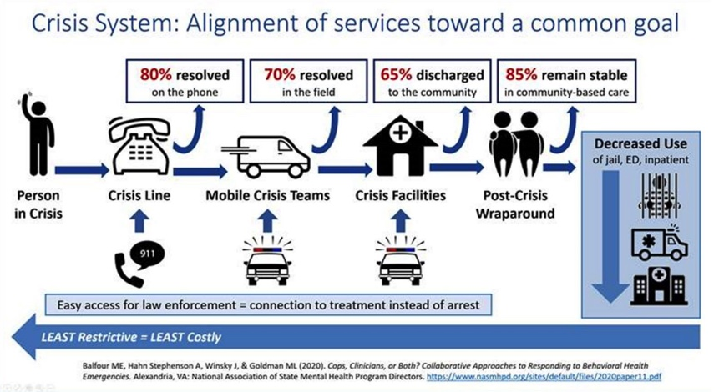
Crisis Services in Alignment
Notes:
SUBJECT MATTER: CRISIS RESPONSE SYSTEM
The diagram from the National Association of State Mental Health Program Directors shows that in a given crisis system, 80% of mental health crises can be resolved on the phone- through the utilization of a crisis line designated specifically for mental health, substance use and suicide crises. A 988 crisis line that is effectively resourced and promoted to be able to:
Connect a person in a behavioral health crisis to trained staff who can address their immediate needs and help connect them to ongoing care
Reduce healthcare spending with more cost-effective early intervention
Reduce the use of law enforcement, public health, and other safety resources
Meet the growing need for crisis intervention
Help end stigma toward those seeking or accessing behavioral healthcare
The Guiding Principles of 988 are:
To provide Universal and convenient access
Public awareness and engagement
Resources for self-help
Multi-channel availability
Reliable and timely response
Connection to resources and follow-up
Localized response
Connection to local public health and safety services
Follow-up as needed
High-quality and personalized experience
Tailored support
Consistency in line with best practices
Reference:
National Association of State Mental Health Program Directors (2020): https://www.nasmhpd.org/sites/default/files/2020paper11.pdf
Image Credit: National Association of State Mental Health Program Directors. Cops, Clinicians, or Both? Collaborative Approaches to Responding to Behavioral Health Emergencies. (August 2020). https://www.nasmhpd.org/sites/default/files/2020paper11.pdf

Slide 8
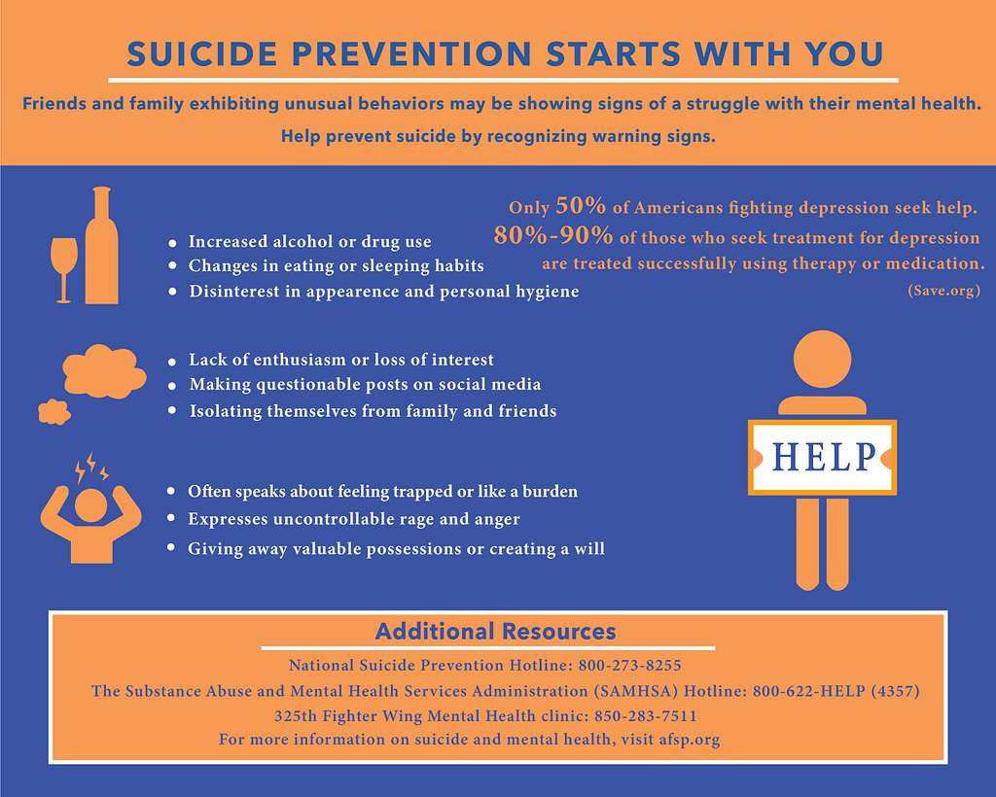
Notes:
SUBJECT MATTER: SUICIDE PREVENTION
Transition slide: Inform students we will be reviewing suicide prevention risk and protective factors, suicide risk assessments, and how to work with someone who is suicidal. Please be aware of how you are responding to the material and how you might have discussions of suicide with your clientele. Suicide is a difficult topic to learn about and experience. Please be considerate of your students when they are sharing.
Image Credit: Picryl

Slide 9
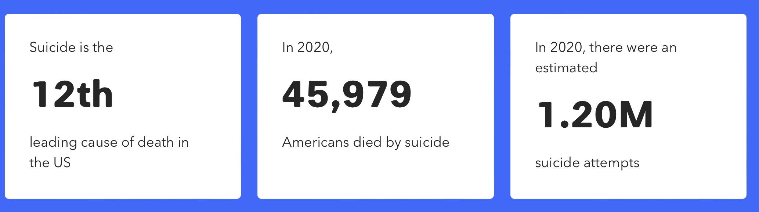
Centers for Disease Control
Mental health challenges and conditions represent our nation’s largest source of disability.
Notes:
SUBJECT MATTER: SUICIDE PREVENTION
45,979 Suicide Deaths
1.2 Million Suicide Attempts
3.2 Million Suicide Plans
12.2 Million People with Suicide Thoughts
75,000 Drug Overdose Death* (Increases 28% in 2021)
References: Center for Disease Control and Prevention (CDC) Data and Statistics Fatal Injury Report for 2020
Image Credit: https://afsp.org/suicide-statistics/

Slide 10
Substance Use and Suicide
Deaths by SUICIDE. In 2020, 18 states had higher suicide death rates compared with 2019, including seven states with statistically significant increases.
ALCOHOL-induced deaths. In 2020, every state and the District of Columbia had higher alcohol death rates compared with 2019.
DRUG-induced deaths. In 2020, 47 states plus the District of Columbia had higher drug-induced drug rates compared with 2019.
Deaths from ALCOHOL, DRUGS, and SUICIDE. In 2020, 49 states and the District of Columbia saw higher rates of death from alcohol, drugs, and suicide combined compared with 2019.
Notes:
SUBJECT MATTER: SUICIDE PREVENTION
Data from 17 states NVDRS (National violent death reporting system)
22% of suicides involve alcohol intoxication, (30-40% of suicide attempts)
Opiates, including heroin and prescription painkillers present in 20% of U.S. suicide deaths.
Marijuana-10%, cocaine-4%, amphetamines-3%
In total, there were 186,763 alcohol-induced, drug-induced, and suicide deaths—or an age-adjusted rate of 54.8 deaths per 100,000 people—in the United States in 2020; this is a 20 percent
increase over 2019 and a 77 percent increase over 2010.
Resource:
Trust for America’s Health (2022): https://www.tfah.org/wp-content/uploads/2022/05/TFAH_2022_PainIntheNation_Fnl.pdf

Slide 11
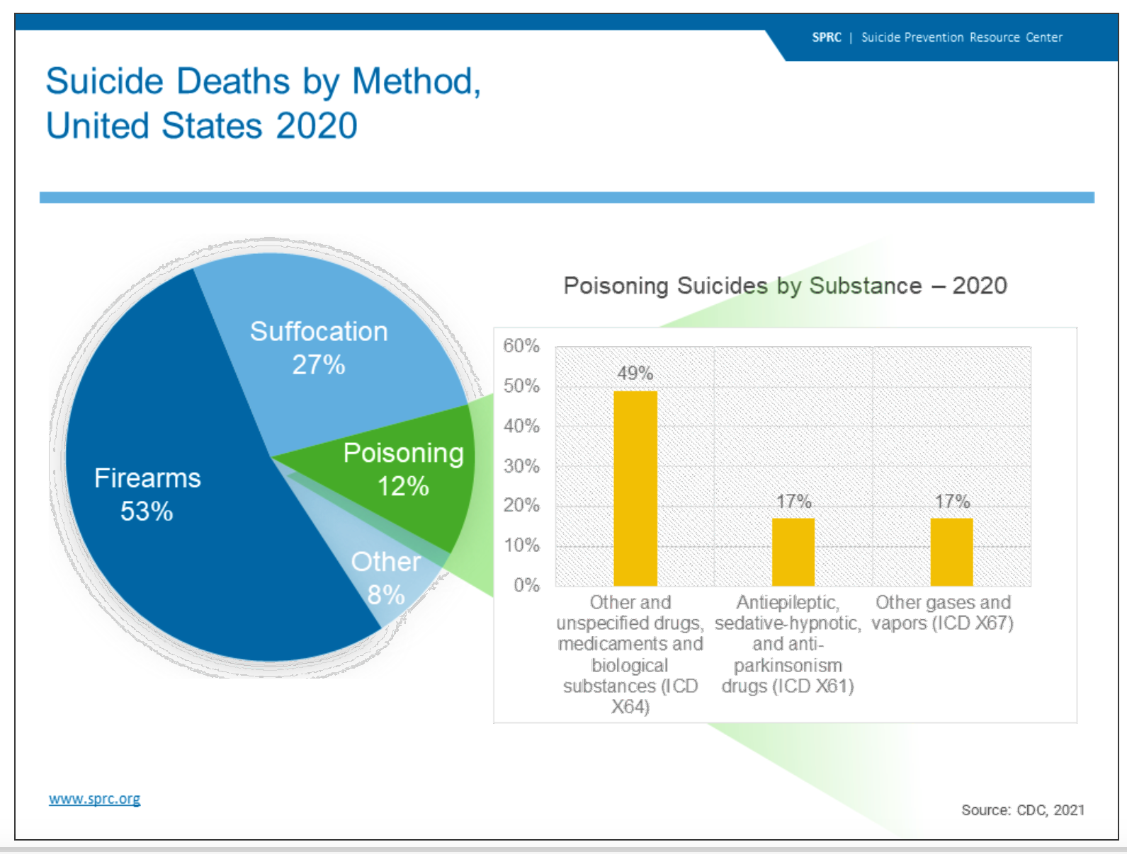
Notes:
SUBJECT MATTER: SUICIDE PREVENTION
Substance Use and Suicide
This pie chart illustrates the means of suicide deaths by various methods.
Firearms accounted for a majority (53%) of the deaths by suicide, followed by suffocation (27%) and other (8%).
Poisonings accounted for 12% of suicide deaths in 2020.
The accompanying bar graph illustrates the contribution of various substances to poisoning suicides. As the graph shows, other and unspecified drugs and medicaments, and biological substances are contributors to over 49% of poisoning deaths.¹
Reference: CDC, 2021
Centers for Disease Control and Prevention, National Center for Health Statistics. (2021). 1999-2020 Wide Ranging Online Data for Epidemiological Research (WONDER), Multiple Cause of Death files [Data file]. Retrieved from http://wonder.cdc.gov/ucd-icd10.html
Center for Behavioral Health Statistics and Quality. (2021). 2020 National Survey on Drug Use and Health: Detailed Tables. Substance Abuse and Mental Health Services Administration, Rockville, MD. Retrieved from https://www.samhsa.gov/data/report/2020-nsduh-detailed-tables
Image Credit: https://sprc.org/about-suicide/scope-of-the-problem/suicide-and-opioids/

Slide 12
Opiates and Suicide – 3 Possible Links
Higher doses of opioids offer increased access to lethal means
Opiates have disinhibiting effects, increasing the likelihood of acting on suicide impulses
People who take higher risk doses share other characteristics that explain the link with suicide
SPRC – Suicide Prevention Resource Center
Notes:
Read slide.
Make the connection that individuals using opiates may have three possible links to suicide as a person with a substance use disorder.
Reference: Suicide Prevention Resource Center (2020) www.sprc.org
Archived webinars on link between opioids and suicide:
https://go.edc.org/opioidwebinar1
https://go.edc.org/opioidwebinar2
SAMSHA Webinar: The Intersection of Opioids and Suicide

Slide 13
Discussion
What are risk factors…
also considered the “drivers” to suicide?
Notes:
SUBJECT MATTER: SUICIDE PREVENTION
Research investigating suicide attempts and deaths by suicide has yielded many specific risk factors and warning signs for future suicidal behaviors. The differences among risk factors, warning signs, and "drivers," are person-specific variables that lead individuals to desire death by suicide.
DISCUSSION:
Read the question aloud and discuss: What are risk factors – also considered the “drivers” to suicide?
After the discussion is finished, go to the next slide for review.
Possible answers:
Death of a loved one
Loss of employment
Legal issues
Financial distress

Slide 14
Sudden changes
in behavior
is a key identifier
that someone may be at risk of suicide
Notes:
Read slide
Reference: is there one for this?

Slide 15
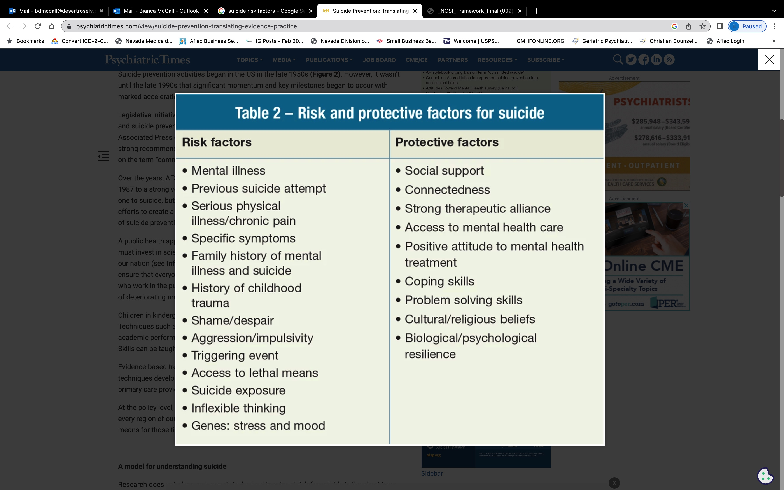
Notes:
SUBJECT MATTER: SUICIDE PREVENTION
The risk and protective factors identified on the screen are used for anyone assessing if a person is at risk for suicide. The list is not all inclusive.
ACTIVITY: Have students read the list of factors. Inquire if they have any questions or concerns about any of the risk or protective factors.
Reference: John Hopkins Medicine. Suicide Prevention in Health Care Systems: Debunking Myths on the Road to Zero Suicide. (slide 36) MN-2021-Presentation-Notes.pdf

Slide 16
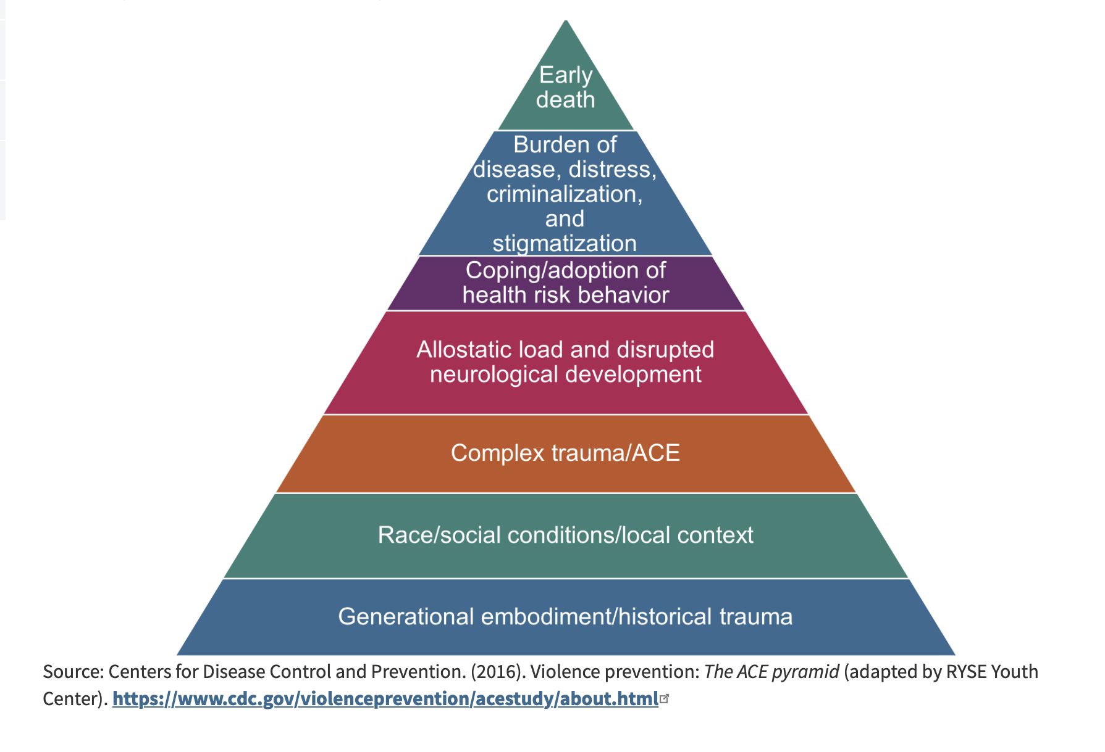
Adverse Childhood Experiences (ACE’s)
Notes:
SUBJECT MATTER: Adverse Childhood Experiences (ACEs)
Information about the foundational ACE study.
READ:
The Original ACE Study
The foundational ACE Study was conducted by the Centers for Disease Control and Kaiser Permanente in the mid-1990s with a group of patients insured through Kaiser Permanente. The initial study focused on how traumatic childhood events may negatively affect adult health. The 17,000 participants surveyed were asked about their experiences with childhood maltreatment, family dysfunction, and current health status and behaviors. The ACEs Pyramid on the left side of the image below represents the conceptual framework created, which illustrates how strongly ACEs are related to a person’s well-being throughout their lifespan.
The ACE study found a direct link between childhood trauma and adult onset of chronic disease, incarceration, and employment challenges. The higher the number of ACEs, the greater the incidence of negative outcomes as captured in the ACE Pyramid. In 2015, the RYSE Center adapted the pyramid as seen on the right side of the image below to include two layers on the bottom that account for the role historical trauma and social location play in a person’s health outcome. This revised model aligns better with the Socio-Ecological Model and accounts for the influences of each sphere on health outcomes.
Reference: https://nhttac.acf.hhs.gov/soar/eguide/stop/adverse_childhood_experiences
Image: https://nhttac.acf.hhs.gov/soar/eguide/stop/adverse_childhood_experiences

Slide 17
Trauma
Notes:
SUBJECT MATTER: TRAUMA
Transition Slide: Now that we have reviewed crisis recognition, suicide prevention, and ACE’s we are going to look at trauma and how it impacts a person.

Slide 18

Trauma
Single event
Reoccurring-strain trauma
Complex trauma
Historical-Intergenerational trauma
Notes:
SUBJECT MATTER: TRAUMA
Trauma is the most misunderstood and misrepresented of the Human experience. There is a lot of trauma-related research occurring, especially post a public health emergency (such as covid). We misrepresent trauma as it has to be something catastrophic- and that there are “worse” traumas than others. Someone who experiences a “worse” trauma deserves more understanding and compassion. All of that is untrue!
TRAUMA IS ANY INCIDENT OR OCCURRENCE WHICH CAUSES A PERSON TO CHANGE THE VIEW OF THEMSELVES, THE WORLD, AND THE RELATIONSHIP BETWEEN THE TWO.
Traumatization is said to occur when both internal and external resources are inadequate to cope with external threats
TRAUMA CAN BE CAUSED BY A SINGLE EVENT, PROLONGED STRESS, AND UNMANAGED DIS-EASE OR CONDITION;
trauma can be COMPLEX and produce intrusive - immediate and/or delayed responses which are disruptive to the five major domains (physical, emotional, cognitive, behavioral, and existential), which we’ll talk about in the next few slides
Trauma can be anticipatory and/or complex. (Anticipatory can include when a person has a loved one at end of life, and we anticipate the grief from the loss/death) It can be historical, related to adverse childhood experiences, or repetitive and persistent intergenerational cycles.
There are more than 50 shades of trauma, canvasing millions of different and co-existing realities.
Reference:
Image Credit: Brain Image - Rawpixel

Slide 19
Common Responses to Trauma
PHYSICAL | EMOTIONAL | COGNITIVE
Nausea and/or gastrointestinal distress Sweating or shivering Faintness Muscle tremors or uncontrollable shaking Elevated heartbeat, respiration, and blood pressure | Numbness and detachment Anxiety or severe fear Guilt (includes survivor guilt) Exhilaration as a result of surviving Anger | Difficulty concentrating Rumination or racing thoughts Distortion of time and space Memory problems
Notes:
SUBJECT MATTER: TRAUMA
So, how do we identify whether or not we are ourselves, or someone we know is experiencing a trauma response- Let’s review the following 5 domains: PHYSICAL, EMOTIONAL, COGNITIVE, BEHAVIORAL, AND EXISTENTIAL.
Evidence of PHYSICAL responses to trauma:
READ (or have a student read) the characteristics
PHYSICAL
may be indicating a response to trauma (not all-inclusive)
Evidence of EMOTIONAL Trauma:
READ (or have a student read) the characteristics
EMOTIONAL
Numbness and detachment ARE a response. Often times first responders will report this. And it’s important to note that numbness is still a response.
Guilt includes survivor guilt as well
Evidence of Cognitive Trauma:
READ (or have a student read) the characteristics
COGNITIVE
Rumination or racing thoughts: for example, replaying the traumatic event over and over again
Distortion of Time and Space: For example, a traumatic event may be perceived as if it was happening in slow motion, or a few seconds can be perceived as minutes.
Memory Problems: when a person is asked for details of a trauma and they say ”I don’t know, or I’m having a hard time recalling details”. This is common and speaks to the brain’s mechanism of protecting the self by storing an experience that has difficult retrieval.
Reference: Bianca McCall, LMFT (2023)

Slide 20
Common Responses to Trauma
BEHAVIORAL | EXISTENTIAL
Startled reaction Restlessness Difficulty expressing oneself Argumentative behavior Withdrawal and apathy Avoidant behaviors Sleep and appetite disturbances Increased use of alcohol, drugs, & tobacco | Intense use of prayer Restoration of faith in the goodness of others (E.G., Receiving help from others) Loss of self-efficacy Despair about humanity, particularly if the event was intentional Immediate disruption of life assumptions (E.G., Fairness, safety, goodness, predictability of life)
Notes:
SUBJECT MATTER: TRAUMA
Next are the Behavioral and Existential domains.
BEHAVIORAL– we typically notice the behavior changes in a person
EXISTENTIAL- these are all responses to trauma
Highlight to students:
We typically see physical and behavioral responses as more obvious when it comes to young people experiencing a trauma response.
Physical, emotional and cognitive responses in high-performance/high-achievement adults
Cognitive and existential responses in middle-aged adults who are parents, and older adults.
AND REMEMBER, THESE RESPONSES MAY BE IMMEDIATE OR DELAYED BY MINUTES, HOURS, DAYS, WEEKS, MONTHS, AND YEARS!
Reference: Bianca McCall, LMFT (2023)

Slide 21

Gabor Maté: The Best Explanation of Addiction I’ve Ever Heard
https://youtu.be/ys6TCO_olOc
Notes:
SUBJECT MATTER: TRAUMA
Let’s take a look at this video that talks about addiction and its connection to trauma.
[PLAY VIDEO]
Gabro Maté: The best explanation of addiction I’ve ever heard. (9:50 minutes) Youtube: https://youtu.be/ys6TCO_olOc
Discussion Topics:
How does the emotional, physical, & spiritual pain a person experiences contribute to a person’s addiction?
Internal resources vary person to person. How does a person access their own resilience?
Reference and additional information can be found at Dr. Gabro Maté official webpage https://drgabormate.com/about/

Slide 22

Notes:
SUBJECT MATTER: CULTURAL CONSIDERATIONS
Transition slide: Next, we are going to review Cultural Considerations and how culture impacts our work as helpers.
Image: Flickr

Slide 23
Cultural Awareness
Having a firm grasp of what culture is and what it is not
Having insight into intracultural variation
Understanding how people acquire their cultures and culture’s important role in personal identities, life ways, and mental and physical health of individuals and communities;
Being conscious of one’s own culturally shaped values, beliefs, perceptions, and biases
Observing one’s reactions to people whose cultures differ from one’s own and reflecting upon these responses
Seeking and participating in meaningful interactions with people of differing cultural backgrounds.
Notes:
SUBJECT MATTER: CULTURAL CONSIDERATIONS
READ: read or select a student to read the slide to define cultural awareness.
Discussion Questions:
Why is it important to be conscious of your own culturally shaped values, beliefs, perceptions, and biases?
Why do you think it is important to seek and participate in meaningful interactions with people from different cultural backgrounds?
What opportunities do you have on campus, to participate in meaningful interactions with people from a different cultural backgrounds?
Key Points:
There are many variations of cultural identity, requiring equal consideration and respect.
Challenging your existing perceptions is what causes change and transformation of thought.
Resource: American Psychiatric Association (2013): https://www.psychiatry.org/File%20Library/Psychiatrists/Practice/DSM/DSM-5-TR/APA-DSM5TR-CulturalFormulationInterviewInformant.pdf

Slide 24

Importance of Cultural Awareness
Cultural awareness is a critical feature of effective health and mental health policy, planning, resource allocation, and service delivery across the entire spectrum of care, including health promotion and prevention.
This is so because cultural perspectives inform people’s identification and interpretation of symptoms and define the diseases, illnesses, and disabilities they recognize. Culture also shapes their ideas of appropriate treatment.
Notes:
SUBJECT MATTER: CULTURAL CONSIDERATIONS
READ: read or select a student to read the slide to define cultural awareness.
Potential Discussion Questions:
What are some examples of how culture informs the identification and interpretation of symptoms and definitions of diseases, illness, and disability? Latino Culture and “possession” and/or religious affliction-
Critical thinking- Is it the professional’s job to ”label’ symptoms as negative?
Key Points:
Perspective is key in both the patient and the provider, during the identification process and recognizing signs and symptoms.

Slide 25

Small Group Discussion
In your group, think about and discuss the first time you were aware of being “different” and what that was like for you.
Notes:
SUBJECT MATTER: CULTURAL CONSIDERATIONS
Small group discussion: break the classroom into groups of 2-5 and provide 5-10 minutes for students to respond to the question on the slide within their group. Have the small group write down similarities and differences. These findings can be shared within the large group or within the small group only. Below are additional questions that can be explored.
Discussion extension: Are we more likely to assign a negative feeling to the experience of being “different”?
If so, why?
Discussion extension: How many of you felt like you were the only one that was ”different” in that way?
If so, how did that make you feel as opposed to knowing there are more people sharing in a similar experience as you, at that moment?

Slide 26
Latino Mental Health
Latinos are a diverse community, including misconceptions and stereotypes regarding Latino history, presence of Latinos in the US, and the difference between Latinos and Hispanics.
Hispanic refers to language whose ancestry comes from a country where Spanish is spoken, Latino refers to geography
 | U.S. Hispanic Origins Groups, 2021
1 | Mexican | 59.9% of Hispanics
2 | Puerto Ricans | 9.3% of Hispanics
3 | Cubans | 4.0% of Hispanics
4 | Salvadorans | 3.8% of Hispanics
5 | Dominicans | 3.8% of Hispanics
(Pew Research, 2021)
Notes:
SUBJECT MATTER: CULTURAL CONSIDERATIONS
READ: read slide
Latinos are a diverse community. There are many misconceptions and stereotypes about who Latinos are and about the history and presence of Latinos in the United States, including the difference between Latinos and Hispanics. While Hispanic refers to language and those whose ancestry comes from a country where Spanish is spoken, Latino refers to geography. Specifically, to Latin America, to people from the Caribbean, South America, and Central America.
Additional Statistics:
According to 2020 Census data, there are 62.1 million Hispanics living in the United States. This group represents 18.9 percent of the total U.S. population, the nation’s second-largest racial or ethnic group after non-Hispanic whites.
The U.S. Hispanic population reached 62.1 million in 2020, an increase of 23% over the previous decade that outpaced the nation’s 7% overall population growth.
The Hispanic population in the U.S. 2021, by origin, Published by Erin Duffin, Oct 5, 2022, As of 2021, 37.24 million people of Mexican descent were living in the United States - the largest of any Hispanic group. Puerto Ricans, Salvadorans, Cubans, and Dominicans rounded out the top five Hispanic groups living in the U.S. in that year.
Resource:
American Psychiatric Association (n.d.) Best Practice Highlights Latino/as and Hispanics. Lisa Fortuna, M.D. APA https://www.psychiatry.org/File%20Library/Psychiatrists/Cultural-Competency/Treating-Diverse-Populations/Best-Practices-Latinos-Patients.pdf
https://www.pewresearch.org/fact-tank/2022/09/23/key-facts-about-u-s-latinos-for-national-hispanic-heritage-month/#:~:text=People%20of%20Mexican%20origin%20accounted,the%20island%20as%20of%202021).
https://www.statista.com/statistics/234852/us-hispanic-population/
HHS: https://minorityhealth.hhs.gov/omh/browse.aspx?lvl=3&lvlid=64

Slide 27
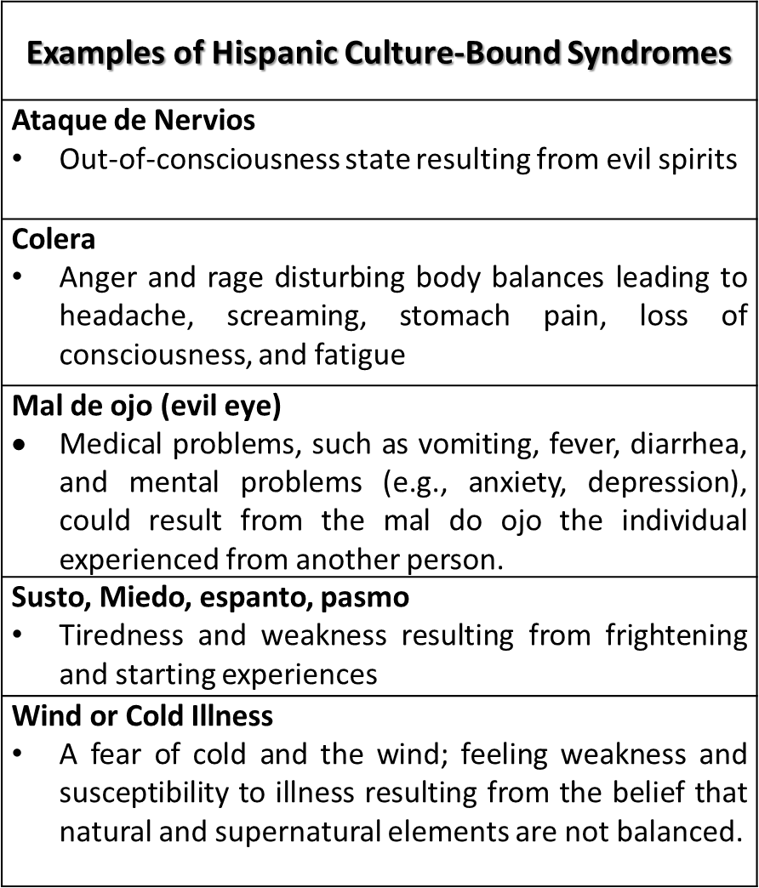

Cultural Differences
(Derived from The Massachusetts General Hospital Textbook on Diversity and Cultural Sensitivity in Mental Health)
Notes:
SUBJECT MATTER: CULTURAL CONSIDERATIONS; Latino Mental Health continued
ADD MORE NOTES Cultural differences between Anglo Americans and Latinos(as)
READ slide.
Image Credit: Modified from Paniagua, F.A. (2000). Culture-bound syndromes, cultural variations, and psychopathology, in I. Cuéllar & F.A. Paniagua, Eds., Handbook of multicultural mental health: Assessment and treatment of diverse populations (pp. 140-141). New York: Academic Press.
Resource:
American Psychiatric Association (n.d.) Best Practice Highlights Latino/as and Hispanics. Lisa Fortuna, M.D. APA https://www.psychiatry.org/File%20Library/Psychiatrists/Cultural-Competency/Treating-Diverse-Populations/Best-Practices-Latinos-Patients.pdf

Slide 28

Notes:
SUBJECT MATTER: COMPASSION FATIGUE
Transition Slide: Next, we will be discussing compassion fatigue and why it is just as important to care for you as it is the people you serve.
Image Credit: www.tagxedo.com word cloud creator

Slide 29

Self Care – Powerful Study Motivation (2020)
Notes:
SUBJECT MATTER: COMPASSION FATIGUE
Introduction of Self-care to your students. “Let’s take a look at this video and its introduction to self-care. While you watch this video, I would like you to think about how this message applies to you.”
[WATCH video]
Youtube: Self Care – Powerful Study Motivation (2020) https://youtu.be/hyO8PNTwyYo (8:06 minutes)
Discussion Questions:
What does self care mean to you?
How do you know when you have enough self care?
Reference: A. Zegan, Motivational2Study (M2S), Self Care-powerful study on motivation (2020). https://www.youtube.com/watch?v=hyO8PNTwyYo

Slide 30

It is essential that students as part of their training learn how to prevent and manage workplace stress and compassion fatigue
‘Students unprepared to address the emotional challenges of social work practice may be at risk of experiencing occupational stress conditions….’
Courtois, 2002; Dunkley & Whelan, 2006; Figley, 2002, p.428
Notes:
SUBJECT MATTER: COMPASSION FATIGUE
This slide highlights the purpose and importance of compassion fatigue for behavioral health students, not just social work students, although that is where much of the research and literature focuses. The developers of this five-part CIP advocate that as part of workforce development strategies, it is best to prepare students to enter the behavioral health field by creating awareness, skills, and knowledge about the emotional/physical demands of the profession. It is important that students understand the occupational hazards associated with working in behavioral health organizations or in healthcare settings.
References:
Courtois, C.A. (2002). Education in trauma practice: Traumatic stress studies, the need for curricula inclusion. Journal of Trauma Practice, 1(1), 33-57.
Dunkley, J., & Whelan, T.A. (2006). Vicarious traumatization: Current status and future directions. British Journal of Guidance and Counselling, 34(1), 107-116.
Figley, C.R. (Ed.) (2002). Treating Compassion Fatigue. New York, NY: Brunner/Routledge.
Newell, J.M. & Nelson-Gardell, D. (2014) A Competency-based approach to teaching professional self-care: An ethical consideration for social work educators. Journal of Social Work Education, 50(3), 427-439. doi:10.1080/10437797.2014.917928.
IMAGE CREDIT: Shutterstock (purchased image).
Slide Credit: Pacific Southwest Addiction Technology Transfer Center Network. Compassion Fatigue and the Behavioral Health Workforce Curriculum Infusion Package. https://uclaisap.org/html2/compassion-fatigue-behavioral-workforce-cip.html

Slide 31

When talking about self-care as an ethical issue, let’s review these important terms -
Compassion Fatigue & Compassion Satisfaction:
  Compassion Fatigue is the emotional and physical fatigue experienced by professionals due to their chronic use of empathy in helping others in distress. Figley, 1995; Newell et al., 2016; Stamm, 2010; Turgoose & Maddox, 2017)
  Compassion Satisfaction refers to those aspects of work that are rewarding and fulfilling to the human service professional. (Conrad & Keller-Guenther, 2006; Stamm, 2005)
Providing help, kindness, empathy, and support can lead to compassion fatigue unless self-care plans, self compassion, and self-awareness activities are put in place.
Notes:
SUBJECT MATTER: COMPASSION FATIGUE
Review the terms compassion fatigue and compassion satisfaction as a reminder for the upcoming ethical discussion with the point being, Do you as a behavioral health professional have an ethical duty to do self-care in order to prevent compassion fatigue?
References:
Figley, C.R. (Ed.) (1995). Compassion Fatigue: Coping with Secondary Traumatic Stress Disorder. New York, NY: Brunner/Mazel.
Figley, C.R. (1996). Review of the Compassion Fatigue Self-Test. In B.H. Stamm (Ed.), Measurement of Stress, Trauma, and Adaptation. Baltimore, MA: Sidran Press.
Figley, C.R. (Ed.) (2002). Treating compassion fatigue. New York: Brunner/Routledge.
Newell, J.M., Gardell, D.N., & MacNeil, G. (2016). Clinician response to client traumas: A chronological review of constructs and terminology. Trauma, Violence, & Abuse, 17, 306-313.
Stamm, B.H. (2010). The ProQOL (Professional Quality of Life Scale: Compassion satisfaction and compassion fatigue. Pocatello, ID: Pro-QOL.org. Retrieved from http://www.proqol.org.
Turgoose, D. & Maddox, L. (2017). Predictors of compassion fatigue in mental health professionals: A narrative review. Traumatology, 23(2), 172–185. https://doi.org/10.1037/trm0000116.
IMAGE CREDIT: Shutterstock (purchased image).
Slide Credit: Pacific Southwest Addiction Technology Transfer Center Network. Compassion Fatigue and the Behavioral Health Workforce Curriculum Infusion Package. https://uclaisap.org/html2/compassion-fatigue-behavioral-workforce-cip.html

Slide 32

Ethics, Compassion Fatigue, and Self Care
Ethical principles state: “First, do no harm” and “Do Good”.
In order to do no harm and to provide effective services behavioral health professionals should care for themselves to ensure quality, ethical services. (Figley, Huggard, & Rees, 2013)
Notes:
SUBJECT MATTER: COMPASSION FATIGUE
Ask students if they have heard of these ethical principles. The intent of this slide is to begin the discussion that behavioral health professionals have an ethical duty to care for themselves in order to prevent and deal with compassion fatigue, burnout, and secondary traumatic stress in an effective manner.
References:
Figley, C.R., Huggard, P., & Rees, C. (2013). Introduction. In C.R. Figley, P. Huggard, & C. Rees (Eds.). First Do No Self-Harm: Understanding and Promoting Physician Stress Resilience. New York, NY: Oxford University Press.
Lachman, V.D. (2016). Compassion fatigue as a threat to ethical practice: Identification, personal and workplace prevention/management strategies. MEDSURG Nursing, 25(4), 275-278.
IMAGE CREDIT: Shutterstock (purchased image).
Slide Credit: Pacific Southwest Addiction Technology Transfer Center Network. Compassion Fatigue and the Behavioral Health Workforce Curriculum Infusion Package. https://uclaisap.org/html2/compassion-fatigue-behavioral-workforce-cip.html

Slide 33

Self-Care as an Ethical Issue
Two terms that reinforce self-care as an ethical issue
Equal regard—a ‘notion that agape (disinterested universal love) requires people to love others neither more nor less than they love themselves. If the nurse operates from the ethical principle of self-sacrifice, self-care is much less likely to be a personal priority.’
(p. 276: a Christian term)
Equanimity—extending compassion to all sentient beings without being overwhelmed by emotional turmoil. (p. 276: a Buddhist term)
Lachman, 2016; Pembroke, 2016
Notes:
SUBJECT MATTER: COMPASSION FATIGUE
Equal Regard and Equanimity are two terms that are found in religious and spiritual tenets but both are applicable to ethical issues regarding a duty for self-care. Discuss students’ reactions to these terms.
A classroom exercise could be conducted at this point in the presentation. Ask students to stand up and then place themselves on a line continuum regarding this statement (agree with the statement and one end and disagree with the statement at the other end)- ‘Ethical codes implicitly require behavioral health professionals to participate in self care activities in order to manage compassion fatigue’. Then process why students placed themselves on the continuum and their reactions to this statement.
References:
Lachman, V.D. (2016). Compassion fatigue as a threat to ethical practice: Identification, personal and workplace prevention/management strategies. MEDSURG Nursing, 25(4), 275-278.
Pembroke, N. (2015). Contributions from Christian ethics and Buddhist philosophy to the management of compassion fatigue in nurses. Nursing and Health Sciences, 18(1), 120-124.
IMAGE CREDIT: Shutterstock (purchased image).
Slide Credit: Pacific Southwest Addiction Technology Transfer Center Network. Compassion Fatigue and the Behavioral Health Workforce Curriculum Infusion Package. https://uclaisap.org/html2/compassion-fatigue-behavioral-workforce-cip.html

Slide 34

Ask Yourself, have I been …
maintaining a professional appearance, including how I dress and groom myself?
adhering to the highest principles of ethical practice (including maintaining client confidentiality, demonstrating respect for clients, and avoiding boundary violations)?
following best practices and evidence-based interventions with clients?
acting in a way that clients and co-workers can trust me as a reliable social worker?
taking steps to continuously improve my competence and the effectiveness of my practice? Barsky, 2015
Notes:
SUBJECT MATTER: COMPASSION FATIGUE
Self-reflection questions continue. The goal of these questions is to raise the behavioral health professional’s awareness and to help them determine if they have experienced behavior changes that may be connected to compassion fatigue. This is just one example of a self-reflection question inventory. Discuss with students why they think these questions might help professionals get at issues of compassion fatigue.
Reference:
Barsky, A. (2015). Being Conscientious: Ethics of Impairment and Self Care. Available at: https://www.socialworker.com/feature-articles/ethics-articles/being-conscientious-ethics-of-impairment-and-self-care/.
IMAGE CREDIT: Shutterstock (purchased image).
Slide Credit: Pacific Southwest Addiction Technology Transfer Center Network. Compassion Fatigue and the Behavioral Health Workforce Curriculum Infusion Package. https://uclaisap.org/html2/compassion-fatigue-behavioral-workforce-cip.html

Slide 35
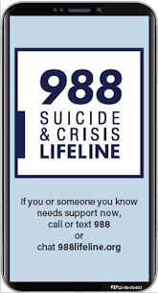
Resources
Suicide Prevention:
Zero Suicide Institute
Zero Suicide Listserv
NV Office for Suicide Prevention
NV Zero Suicide Initiative
The Lifeline and 988
UNR LiveWell Resource Page
Notes:
Resources are provided and should assist in maintaining important referral agencies/support services as well as resources for students.
Zero Suicide Institute: https://zerosuicideinstitute.com/
Zero Suicide Listserv: https://zerosuicide.edc.org/movement/zero-suicide-listserv
NV Office for Suicide Prevention: http://suicideprevention.nv.gov/
NV Zero Suicide Initiative: https://nvopioidresponse.org/initiatives/zs/
The Lifeline and 988: https://988lifeline.org/current-events/the-lifeline-and-988
UNR LiveWell Resource Page: https://www.unr.edu/livewell
Image Credit: SAMHSA 988 Partner Toolkit

Slide 36
Resources
Community Resources:
UNR Disabilities Resource Center
Nevada Center for Excellence in Disabilities Directory
CASAT on Demand Resources & Downloads
Pacific Southwest Addiction Technology Transfer Center (PSATTC)
The Mental Health Technology Transfer Center Network
The Prevention Technology Transfer Center Network
Dep. of Health & Human Services Aging and Disability Services Division
SAMHSA’s Technology Transfer Center (TTC) Programs
Notes:
Resources are provided and should assist in maintaining important referral agencies/support services as well as resources for students.
Community Resources:
UNR Disabilities Resource Center: https://www.unr.edu/drc
Nevada Center for Excellence in Disabilities Directory: https://www.unr.edu/education/faculty-and-staff/nevada-center-for-excellence-in-disabilities
CASAT on Demand Resources & Downloads: https://casatondemand.org/resources_downloads/
Pacific Southwest Addiction Technology Transfer Center (PSATTC): https://attcnetwork.org/centers/pacific-southwest-attc/home
The Mental Health Technology Transfer Center Network: https://mhttcnetwork.org/
The Prevention Technology Transfer Center Network: https://pttcnetwork.org/
Department of Health & Human Services Aging and Disability Services Division: https://adsd.nv.gov/
SAMHSA’s Technology Transfer Centers (TTC) Programs: techtransfercenters.org

Slide 37
Notes:
The Pathways in Crisis Services (PICS) Project provides academic course and professional learning events and content focused on evidence-based crisis programs that include crisis intervention, de-escalation services, mobile crisis and crisis stabilization for Pre-service (students) and Practicing Behavioral Health Professionals with the goal of increasing knowledge and skills leading to use in practice.
This is accomplished by guaranteeing students get exposed to crisis intervention services and skills while in school in order to prepare them to do crisis intervention services which includes: risk determination; early intervention; de-escalation strategies; how to conduct warm-hand-off; and understanding the new (988) system through the development of curriculum infusion and training. Practicing Professionals will have the opportunity to attend a variety of training and technical assistance (T/TA) events to ensure that T/TA in crisis-based programs is available to help prepare these professionals with the knowledge and skills to provide crisis-based services.
This project was supported in whole or in part by the Nevada Division of Public and Behavioral Health Bureau of Behavioral Health, Prevention, and Wellness. The opinions, findings, conclusions and recommendations expressed in this publication are those of the author(s) and do not necessarily represent the official views of the State of Nevada or CASAT.

